Slide 1
What’s new in Renal Supportive Care literature
Survival
Frailty
Symptoms
ACP
Key publications

Slide 2
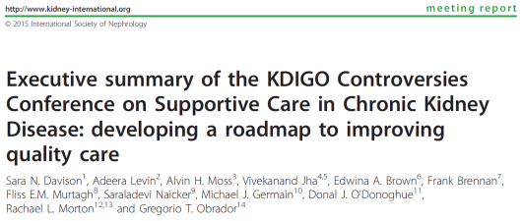
“Rates of hospitalization, ICU admissions, and other intensive treatments are higher for CKD patients in the last month of life compared with other
severe chronic illnesses, including chronic obstructive lung
disease, congestive heart failure, and advanced liver disease.”
“Supportive care helps patients cope with living, as well as dying, regardless of life expectancy.”

Slide 3
Survival with and without dialysis

Slide 4
ANZDATA 2014 report

Slide 5

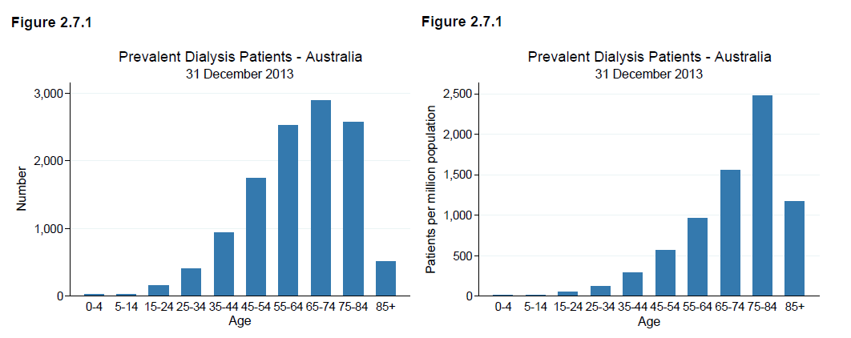
11,774 dialysis patients at end of 2013
ANZDATA 2014

Slide 6
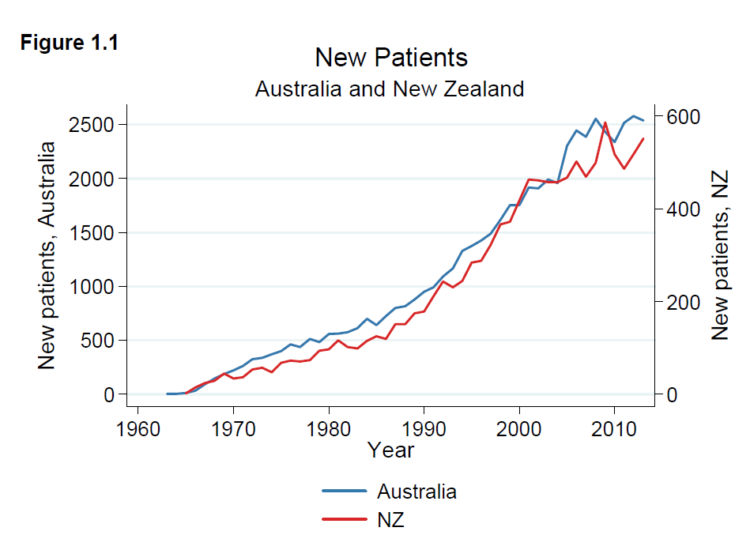
ANZDATA 2014

Slide 7
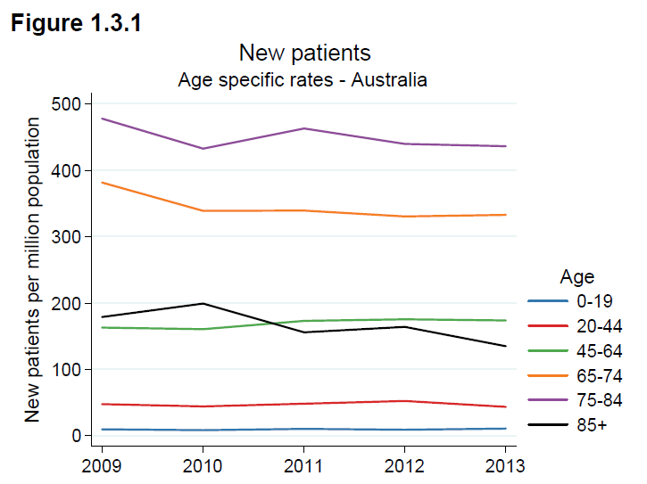
Perhaps some reduction in very elderly patients choosing dialysis?
ANZDATA 2014

Slide 8
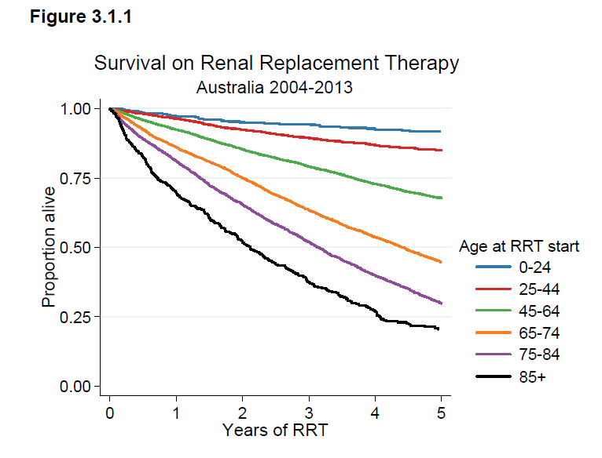
75-84 yrs. – 81 & 66% 1 & 2 yr. survival
85+ yrs. – 70 & 52% 1 & 2 yr. survival

Slide 9
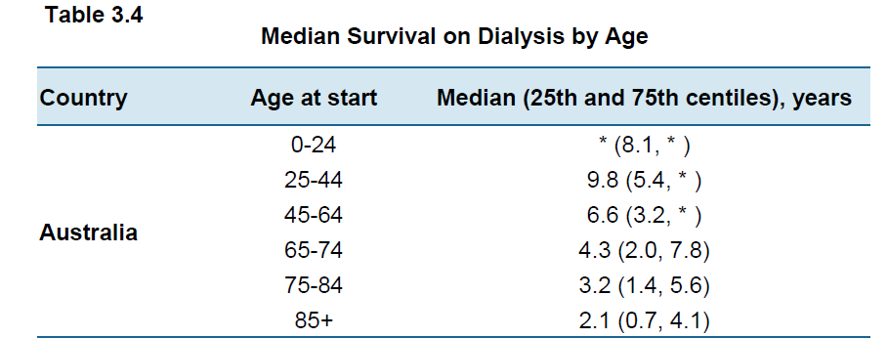
ANZDATA 2014

Slide 10
Survival perspective – Australian Data
overall 5 year survival rates
  prostate cancer 92%
  breast cancer 89%
  renal cancer 72%
  bowel cancer 66%
  dialysis in Australia
    aged 45-64 60%
  Heart failure 52%
  ovarian cancer 43%
  dialysis in Australia
    aged 65-74 43%
    aged 75-84 27%
  lung cancer < 14%
  Data from the Cancer Council of Australia (www.cancer.org.au) and ANZDATA 2012 (www.anzdata.org.au); JAMA. 2004; 292(3):344.

Slide 11
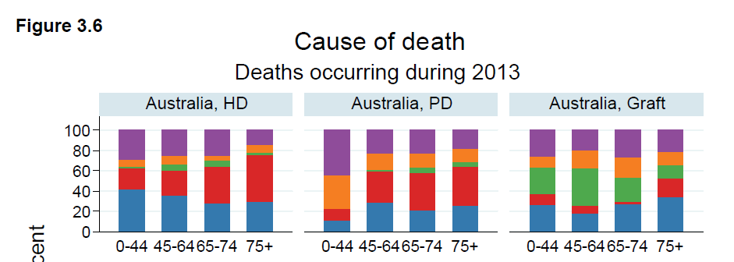
cardiovascular
withdrawal
ANZDATA 2014

Slide 12
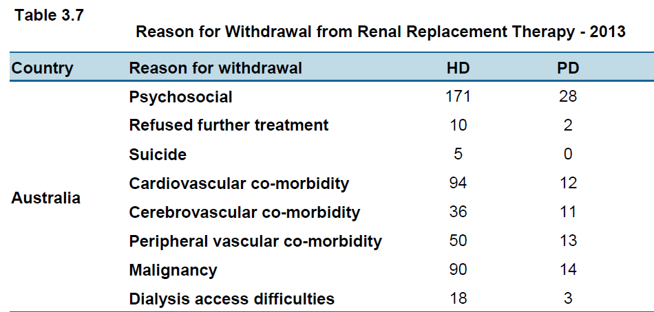
Most withdrawal after 2 years on dialysis
ANZDATA 2014

Slide 13
Can we predict dialysis mortality?

Slide 14
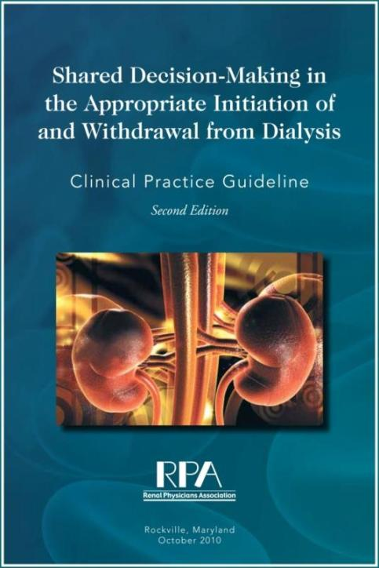
Clinical Practice Guidelines
Renal Physicians Association, American Society of Nephrology Guidelines 2010
Importance of joint decision using a systematic approach to communicate about diagnosis, prognosis, treatment options, and goals or care for patients with ESKD
Includes tools to assess for depression, cognitive impairment, and decision-making capacity
www.renalmd.org/End-Stage-Renal-Disease

Slide 15
Those aged >75 with stage 5 CKD who meet 2 or more of the following statistically significant very poor prognosis criteria:
  Clinician’s response of “no, I would not be surprised” to the surprise question (“would I be surprised if this patient died in the next year?)
  High co-morbidity score
  Significantly impaired functional status
  Severe malnutrition

Slide 16
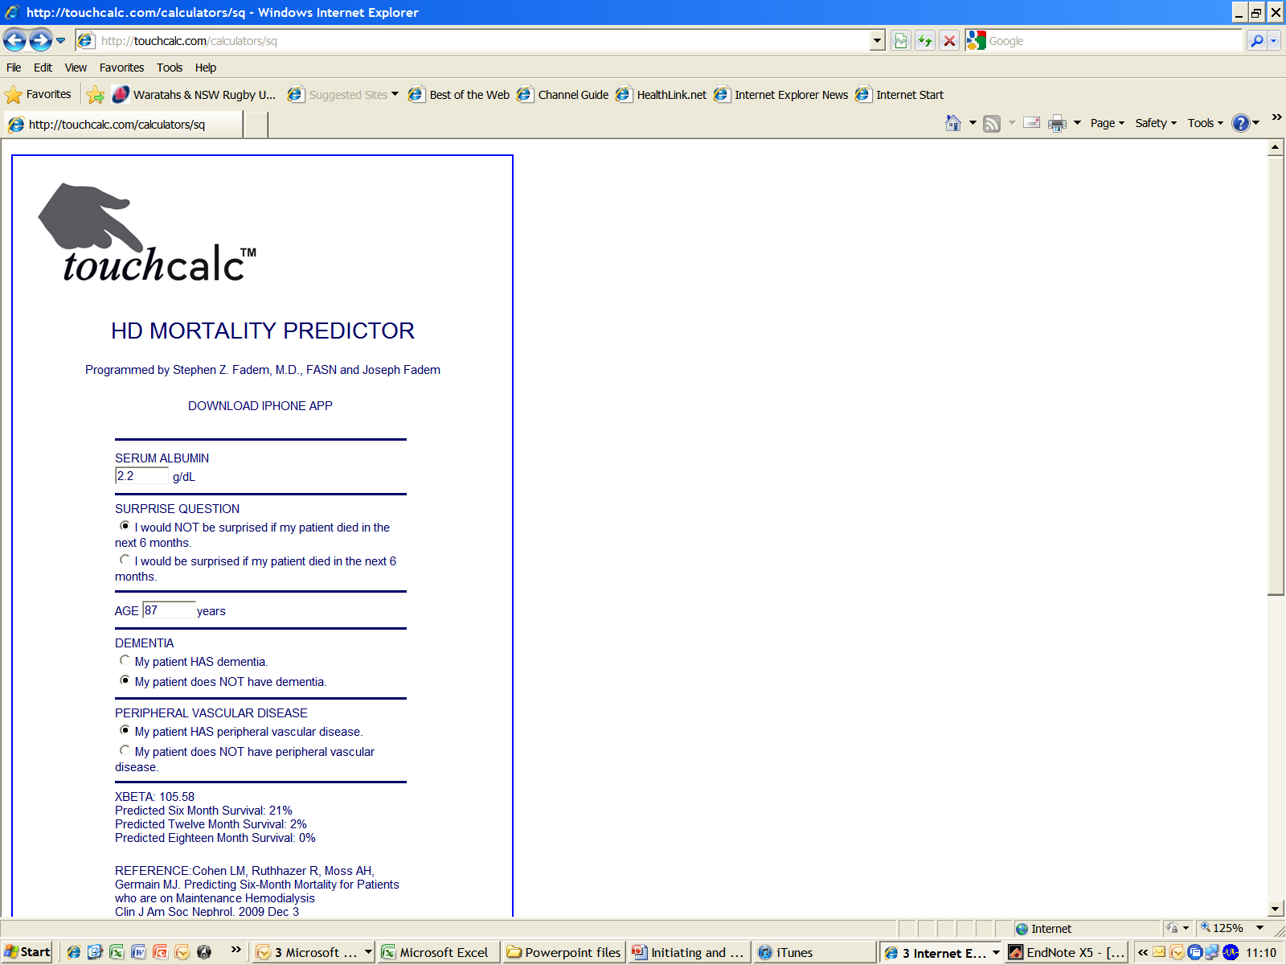

Slide 17

11,500 European HD patients recruited 2007 – 2009
The equations validated in DOPPS population data

Slide 18
Predictors of 1 & 2 yrs. dialysis mortality
Clinical markers
  Increasing age, low BMI,
  history of cardiovascular disease or cancer,
  use of a vascular access catheter during baseline
Laboratory markers
  hemoglobin, ferritin,
  C-reactive protein,
  serum albumin, and creatinine

Slide 19
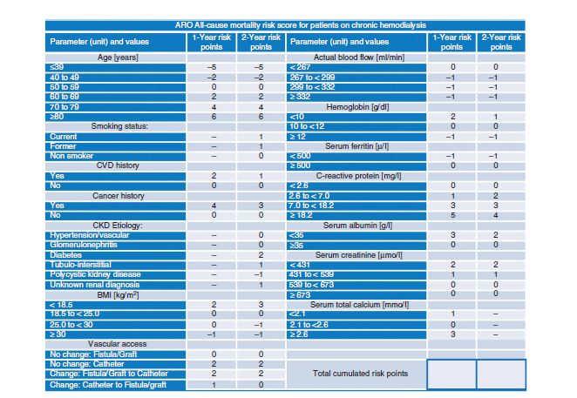

Slide 20
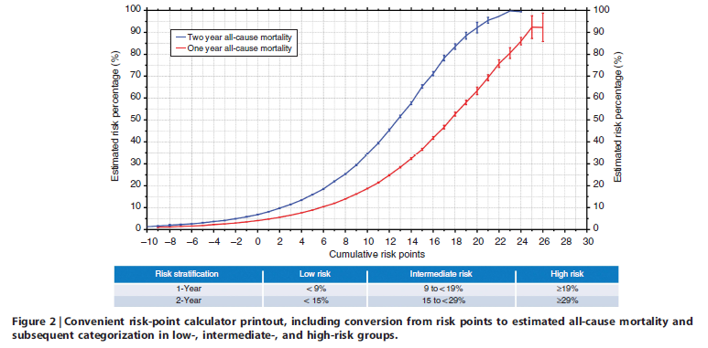
Use this to undertake Advance Care Planning?

Slide 21
Survival without dialysis?

Slide 22
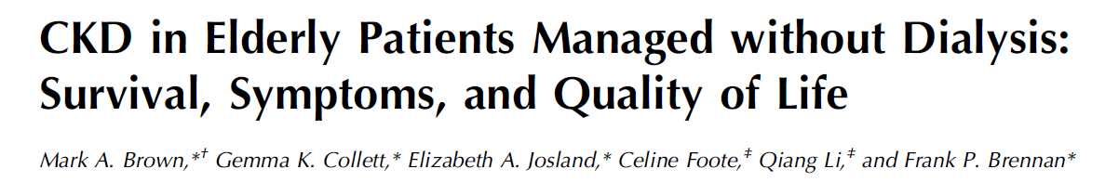
CJASN February 06, 2015 vol. 10 no. 2 260-268

Slide 23
Risk of dying in non-dialysis RSC group
Mean survival (age 82) 20 months; median survival 16 months
4 fold risk death vs. Pre-dialysis group age >75 and eGFR <15
  i.e. age itself not a major factor in survival
Same risk of death as all dialysis patients if age >75 and
>2 co-morbidities, one being IHD or CCF
  N= 70; HR 2.1(0.92, 4.76); p=0.08
  CCF affected survival only in non-dialysis patients
  IHD affected survival only in dialysis patients

Slide 24
Frailty

Slide 25
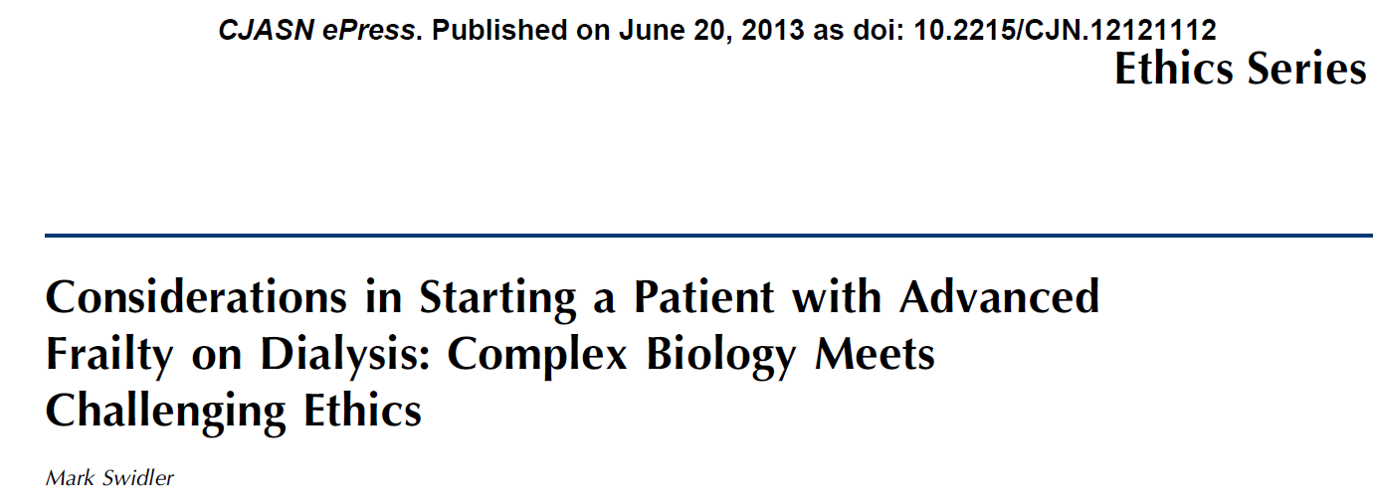
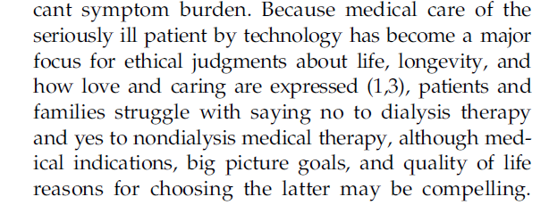
Frailty in 15% of ESKD patients vs. 8% aged care clinic patients (USA)
Symptoms of frailty overlap with ESKD – dialysis started earlier in frail patients

Slide 26
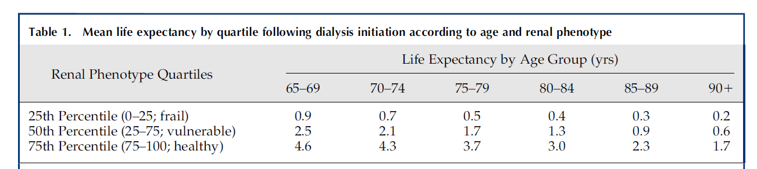
The effects of frailty on survival
Swidler

Slide 27
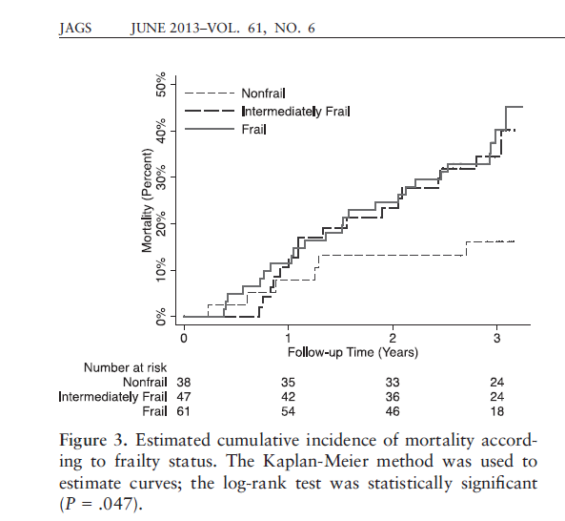
Frailty linked to mortality on HD
Frailty diagnosed by method of Fried et al:
Wt loss 5kg dry weight past 12 months
Poor grip strength
Exhaustion
Low activity
Slow walking speed
Others include
ability to conduct ADLs
Karnofsky performance score
146 patients; Baltimore. USA. – High rates of frailty

Slide 28
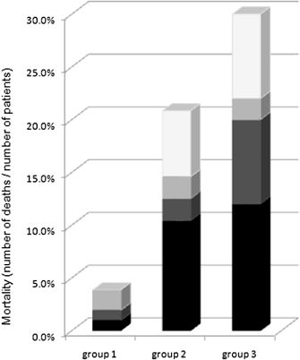
Decreased mobility after starting dialysis is an independent risk factor for short‐term mortality within 6 months after initiation of dialysis
Causes of death classified based on mobility: independent mobility at onset of dialysis and preservation of mobility after starting dialysis (group 1, n = 104), independent mobility at the start of dialysis and decline in mobility after starting dialysis (group 2, n = 48) and impaired mobility at the start of dialysis (group 3, n = 50).
□, other; , malignancy; , vascular events; ■, infection.
202 patients (age, >75 years; mean, 80.4 ± 4.3)
retrospective cohort study, Yokosuka, Japan
Nephrology
Volume 19, Issue 4, pages 227-233, 24 MAR 2014 DOI: 10.1111/nep.12202
http://onlinelibrary.wiley.com/doi/10.1111/nep.12202/full#nep12202-fig-0001
Notes:
Causes of death classified based on mobility: independent mobility at onset of dialysis and preservation of mobility after starting dialysis (group 1, n = 104), independent mobility at the start of dialysis and decline in mobility after starting dialysis (group 2, n = 48) and impaired mobility at the start of dialysis (group 3, n = 50). □, other; , malignancy; , vascular events; ■, infection.
© This slide is made available for non-commercial use only. Please note that permission may be required for re-use of images in which the copyright is owned by a third party.

Slide 29
Symptoms

Slide 30
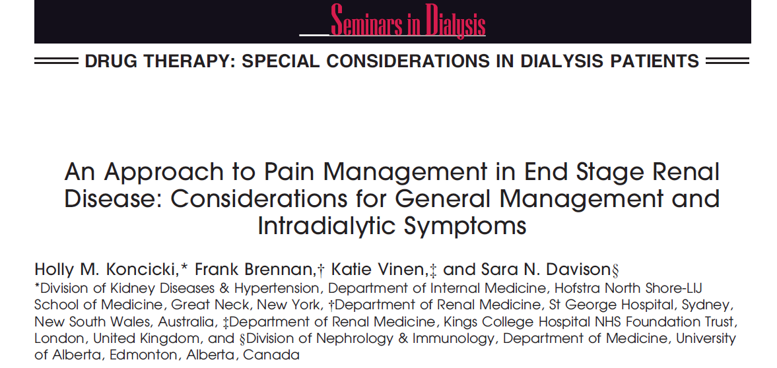

Slide 31
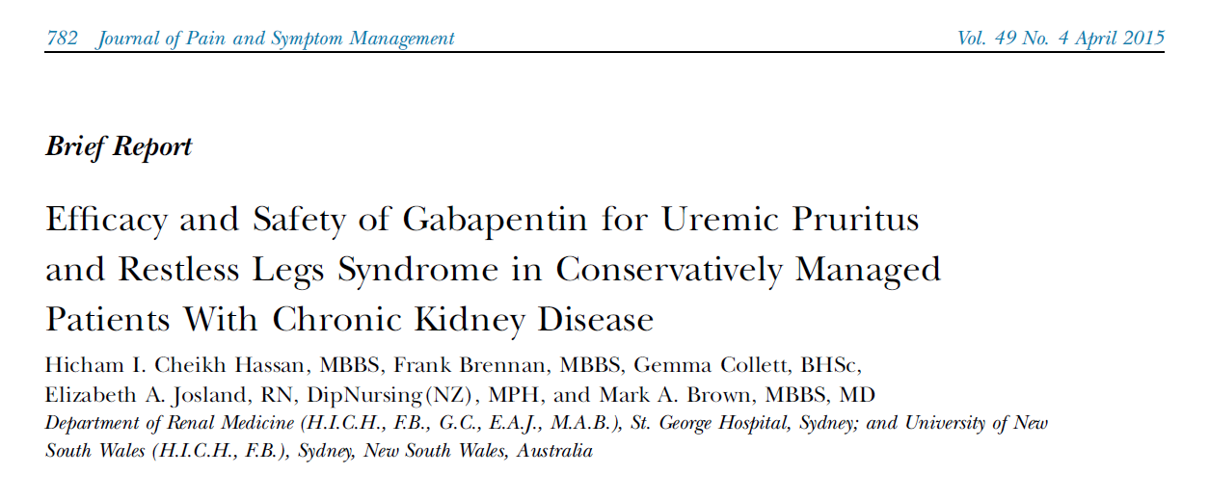

Slide 32
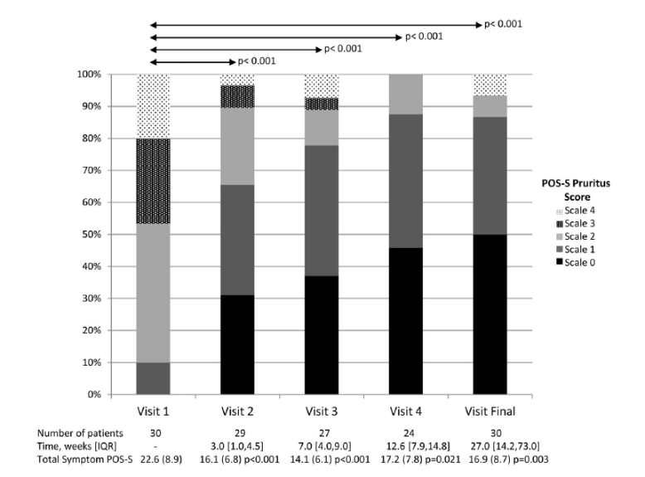
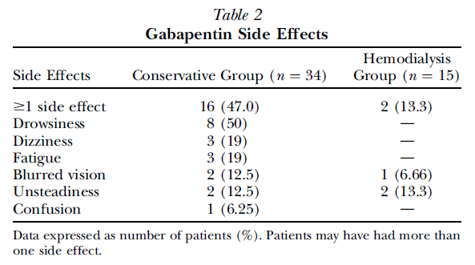
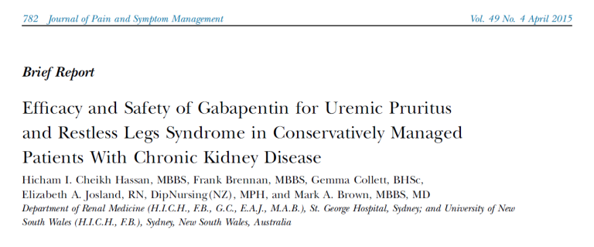
17% discontinued the drug

Slide 33
Symptom burden – St George patients (unpublished)
% of patients responded Severe/ overwhelming to each symptom, Apr and Nov 14
 | Hosp HD % |  | Home HD % |  | PD % |  | Transplant %
 | Apr-14 (n=90) | Nov-14 (n=133) | Apr-14 (n=49) | Nov-14 (n=44) | Apr-14 (n=24) | Nov-14 (n=19) | Apr-14 (n=74) | Nov-14 (n=99)
Pain | 9 | 11 | 8 | 11 | 4 | 5 | 8 | 4
Shortness of Breath | 4 | 9 | 4 | 0 | 8 | 5 | 5 | 3
Weakness or lack of energy | 14 | 11 | 17 | 11 | 14 | 16 | 12 | 9
Nausea | 1 | 3 | 0 | 0 | 2 | 0 | 4 | 2
Vomiting | 0 | 0 | 0 | 0 | 2 | 0 | 1 | 0
Poor Appetite | 4 | 3 | 0 | 0 | 4 | 7 | 1 | 1
Constipation | 9 | 8 | 8 | 5 | 6 | 7 | 3 | 2
Mouth Problems | 4 | 2 | 4 | 5 | 8 | 2 | 4 | 0
Drowsiness | 11 | 8 | 4 | 0 | 14 | 2 | 5 | 5
Poor Mobility | 18 | 13 | 8 | 5 | 10 | 11 | 5 | 5
Itching | 8 | 5 | 4 | 5 | 10 | 5 | 1 | 0
Difficulty Sleeping | 17 | 12 | 13 | 16 | 6 | 16 | 14 | 10
Restless Legs | 9 | 5 | 8 | 16 | 4 | 7 | 4 | 3
Feeling anxious | 4 | 5 | 13 | 5 | 2 | 5 | 5 | 2
Feeling depressed | 6 | 5 | 8 | 5 | 2 | 2 | 7 | 5
Changes in Skin | 6 | 7 | 0 | 5 | 4 | 5 | 7 | 6
Diarrhoea | 0 | 2 | 0 | 0 | 0 | 2 | 5 | 1
No association between symptom scores and mode of RRT

Slide 34
Advance Care Planning

Slide 35
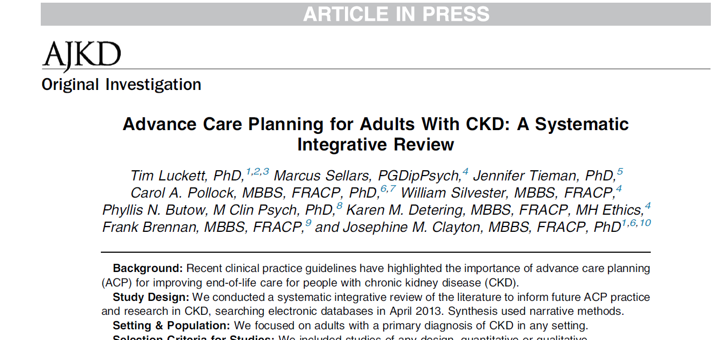

Slide 36
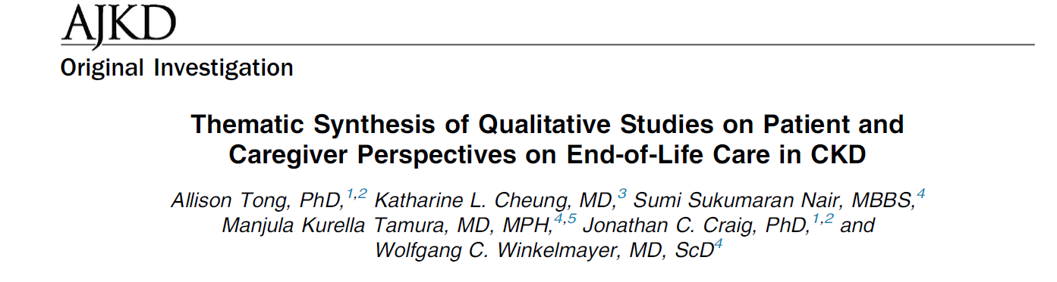
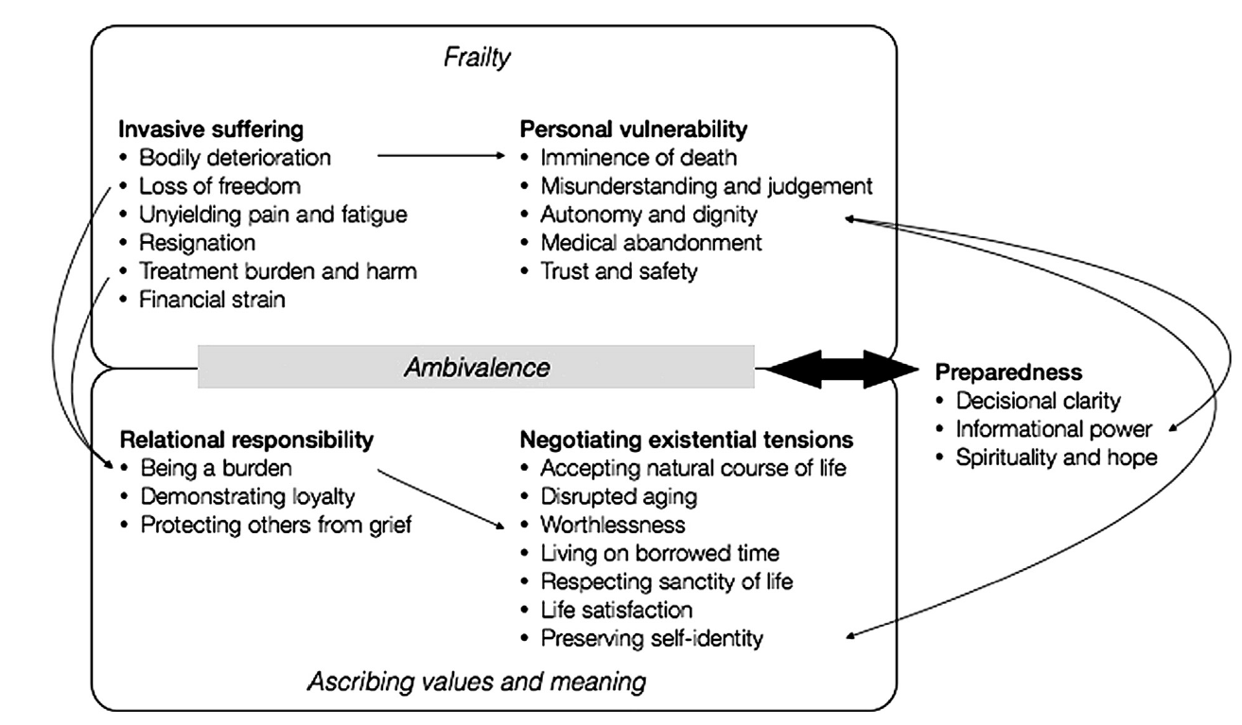
2014

Slide 37
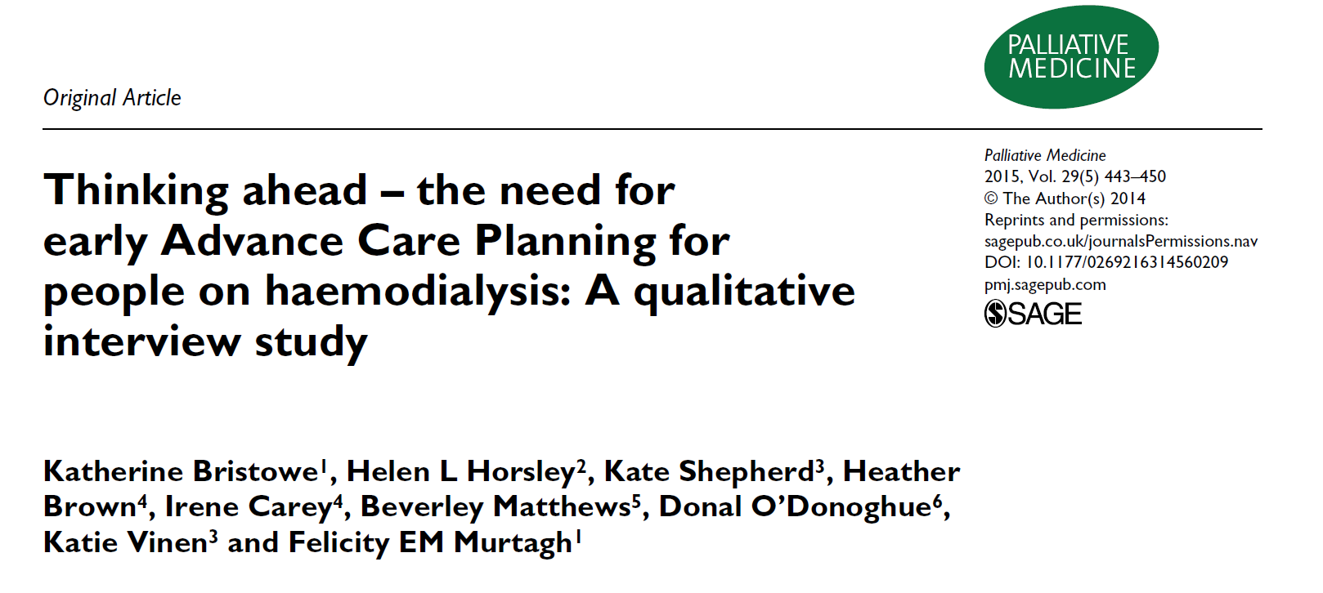

Slide 38
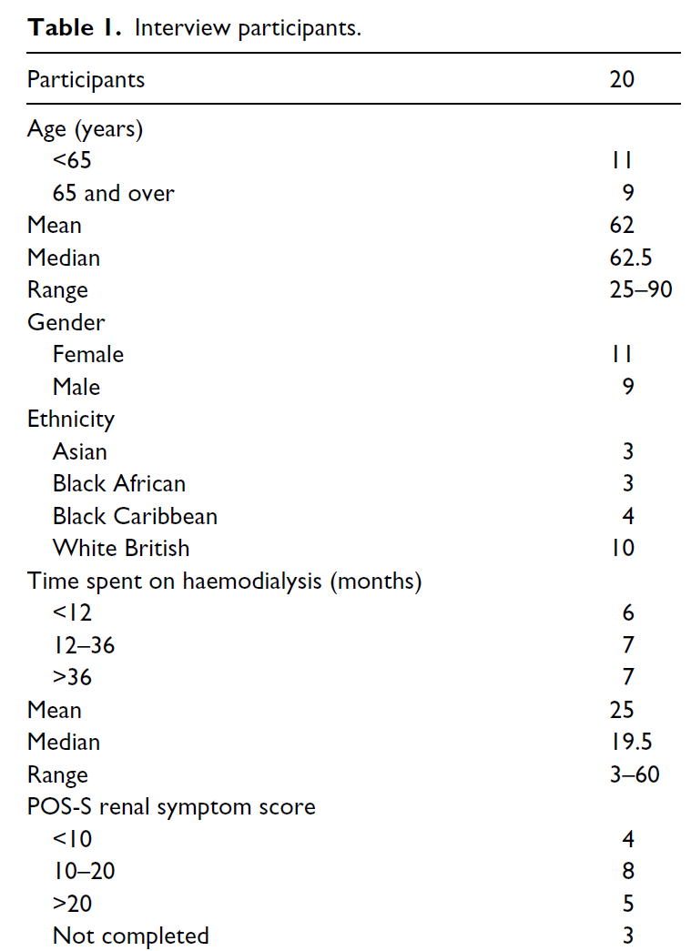

Slide 39
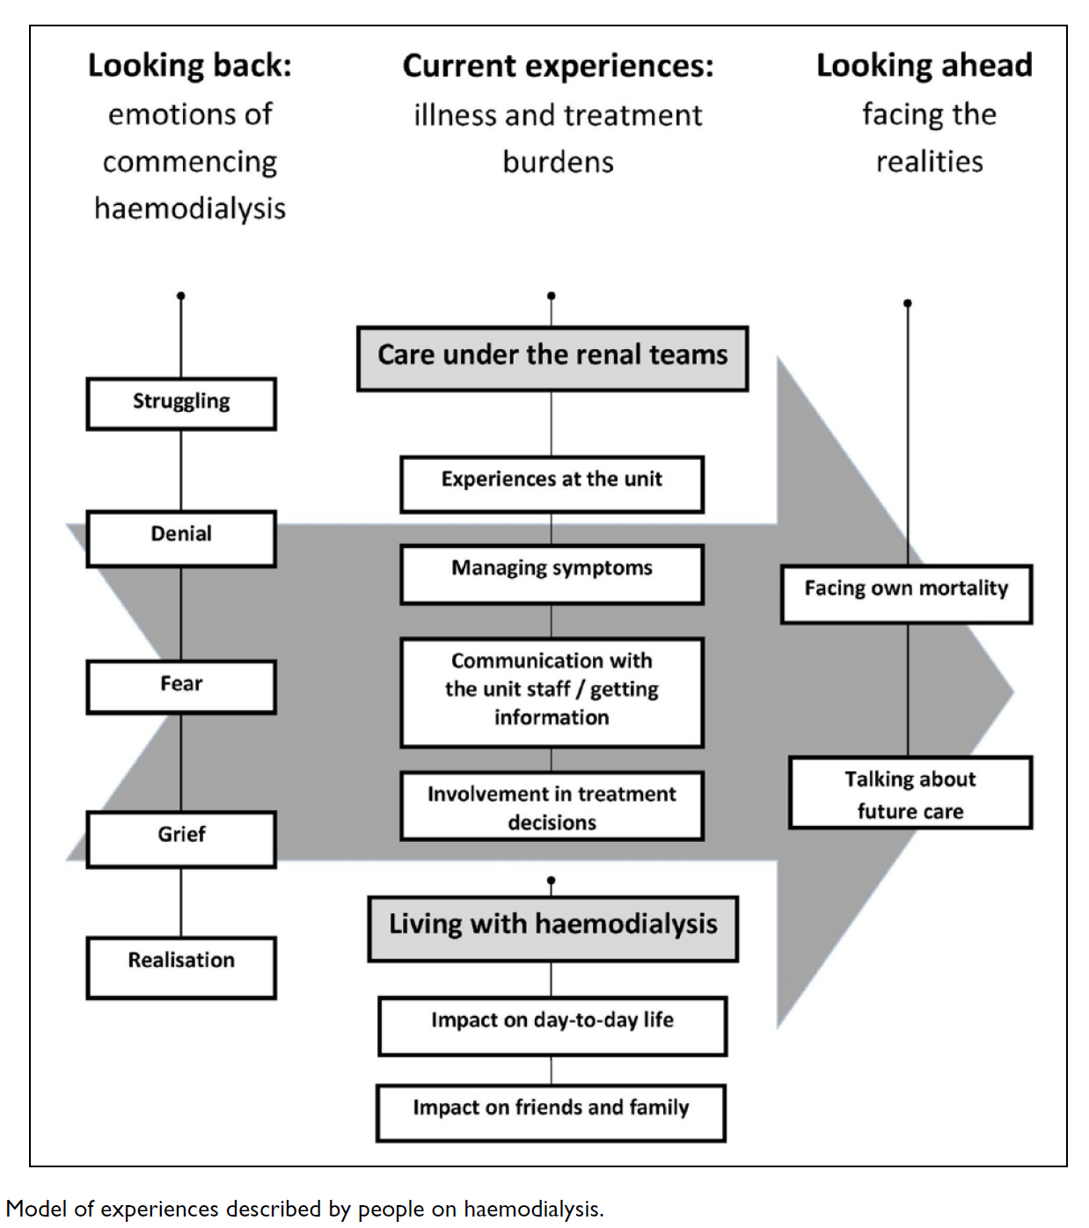
Themes and understanding emerging from the study

Slide 40

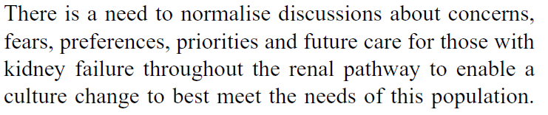
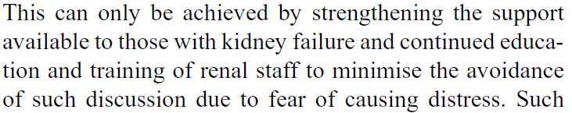

Slide 41
Decision making

Slide 42
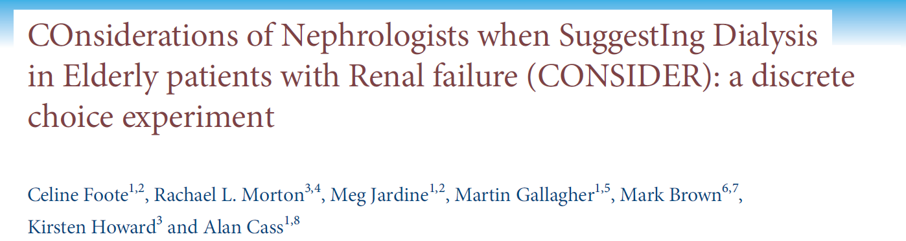
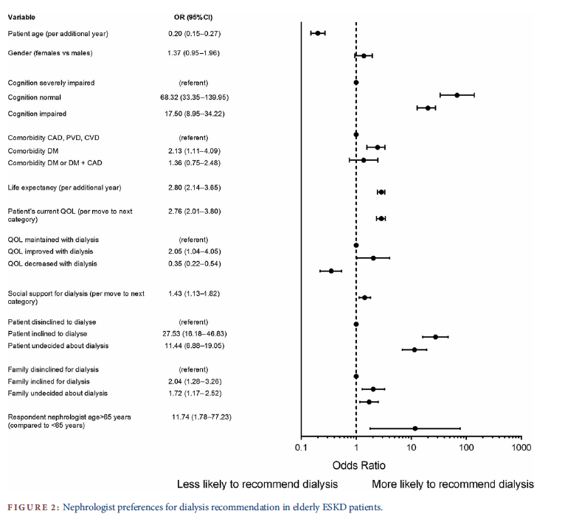
NDT 2014

Slide 43
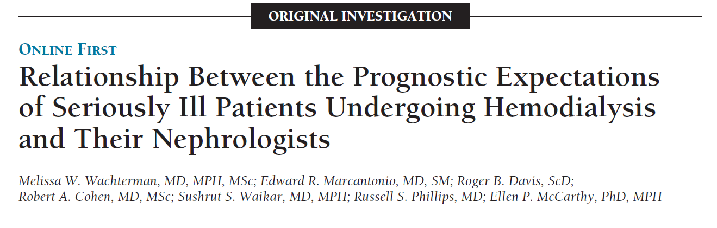
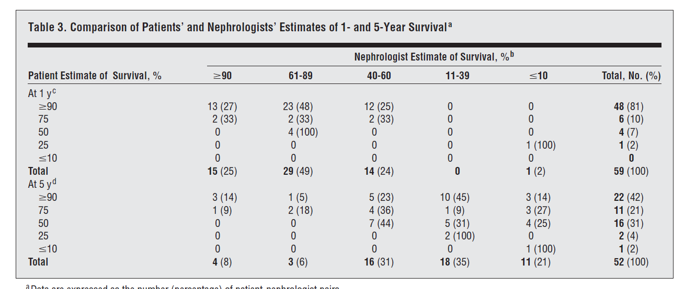
JAMA 2013

Slide 44
2 key publications

Slide 45
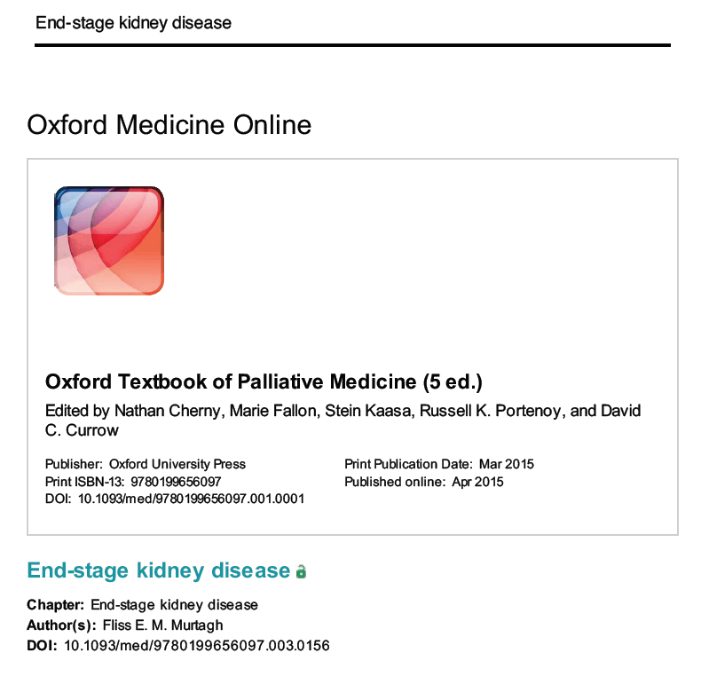

Slide 46
Murtagh 2015 – key points
Survival without dialysis
  A prospective RCT vs. dialysis is unlikely
  Murtagh – 68 and 47% 1 and 2 yr. survival without dialysis
  Survival advantage of dialysis lost with high co-morbidity
  Survival after dialysis withdrawal 8-10 days if no RRF
Symptoms ( roughly equal in elderly dialysis & conservative managed)
  Burden similar to advanced cancer patients but different pattern
  Anxiety & depression about 50%
  Pain 50%
  Pruritus, RLS, difficulty sleeping all common

Slide 47
Murtagh 2015 – key points
Pain
  Avoid codeine; limit tramadol to 50mg bd
  Fentanyl preferred opioid - <10% renally excreted but monitor
  Hydromorphone : awaiting more data
  Buprenorphine – mostly liver metabolism
  Methadone : dose reduction 50% & watch individual variable response
  Oxycodone : concerns over accumulation; halve dose
Fatigue
  Consider renal failure per se; dialysis per se; co-morbid conditions
Nausea
  Metoclopramide; haloperidol; ondansetron

Slide 48
Murtagh 2015 – key points
Pruritus
  Skin (C-fibres) then afferent pathway via contralateral STh tract
  From hypothalamus & thalamus to distinct cortical areas
  Mediate desire to scratch from motor cortex
    Treatment therefore depends on which component most dominant
      Manage phosphate, PTH, dry skin
      Emolients; thalidomide; Evening Primrose oil; UV-B; gabapentin
RLS & difficulty sleeping interact

Slide 49
Murtagh 2015 – key points
Advance Care Planning
  Does not remove patient’s hope
  Not just about medical decisions
  Includes
    Family relationships
    Resolution of conflicts
    Living well until end-of-life

Slide 50


Slide 51

Framework for supportive care in chronic kidney disease (CKD)
Curative/remittive care
Hospice
care
Palliative/supportive care
Bereavement
Death
Patient is identified as dying
(usually prognosis6 months).
KDIGO. Davison. Kidney International advance online publication, 29 April 2015

Slide 52
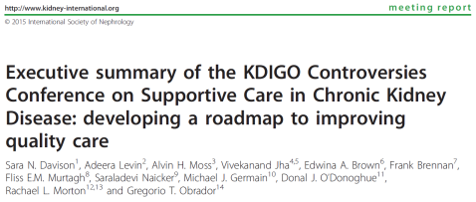
Table 2 | Symptom assessment and management recommendations
Regular symptom screening using validated tools such as the ESAS-r:Renal and POS-renal should be incorporated into routine clinical practice in advanced CKD.
First-line treatment includes non-pharmacological interventions. Second-line treatment is pharmacologic therapy.
Current evidence is sufficient to support the development of clinical guidelines to manage uremic pruritus, sleep disturbances, restless legs syndrome, pain, and depression in CKD.
Symptom management is a research priority in CKD.

Slide 53

Table 3 | Estimating prognosis recommendations
Estimate and communicate prognosis to patients and family, balancing biomedical facts with relevant emotional, social, cultural, and spiritual issues.
It will aid in the timely identification of patients who are most likely to benefit from supportive care and is essential for quality care.
Develop a comprehensive methodological guideline for designing and assessing the quality of prognostic tools in CKD.
  Beyond survival to include outcomes that matter most to patients and families in diverse countries and cultures, such as HRQL.
Derive and validate prognostic tools for clinical outcomes that are most relevant to patients using existing and future databases.

Slide 54
Table 5 | Withdrawal of dialysis
Withdrawal from dialysis is ethically and clinically acceptable after a process of shared decision making.
  First address potentially remedial factors contributing to the decision such as depression or other symptoms or reversible social factors.
Ensure access to appropriate supportive and/or hospice care as an integral part of the care following a decision to withdraw dialysis.

Slide 55
Table 5 | Withdrawal of dialysis
Situations in which it is appropriate to withdraw dialysis include :
  Patients with decision-making capacity, who refuse dialysis or request that dialysis be discontinued.
  Patients who no longer possess decision-making capacity who have previously indicated refusal of dialysis through appropriate ACP.
  Patients who no longer possess decision-making capacity and whose properly appointed legal agents/surrogates refuse dialysis or request that it be discontinued.
  Patients with irreversible, profound neurological impairment such that they lack signs of thought, sensation, purposeful behaviour, and awareness of self and environment.

Slide 56

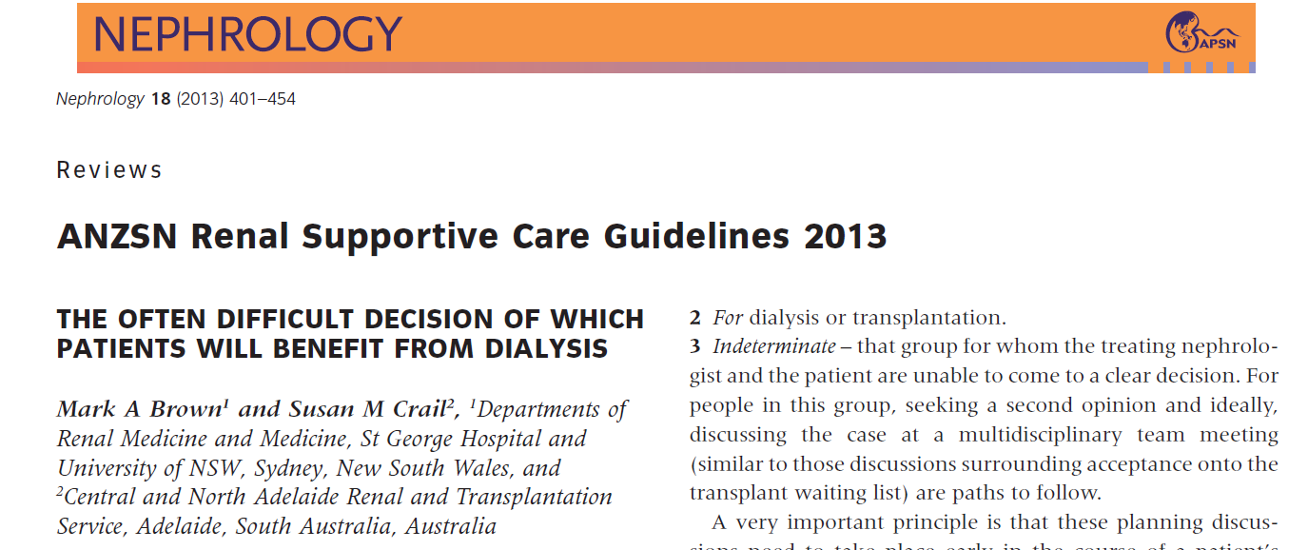

Slide 57
How can we use this new literature?
Discussion guide for the nephrologist
Likely Survival
QOL / frailty / co-morbidity / nutrition
Informed consent for dialysis
Advance Care Plans
Ethics as a guide to decision making
  Autonomy as one principle only
Spirituality and Religion
Hope
Guidelines
Second and third opinions

