Slide 1
Keeping the End in Sight
The role of a Renal Social Worker in a Renal Supportive Care Team.

Slide 2
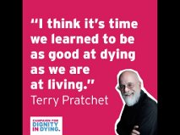

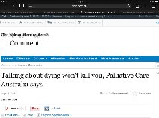

Slide 3
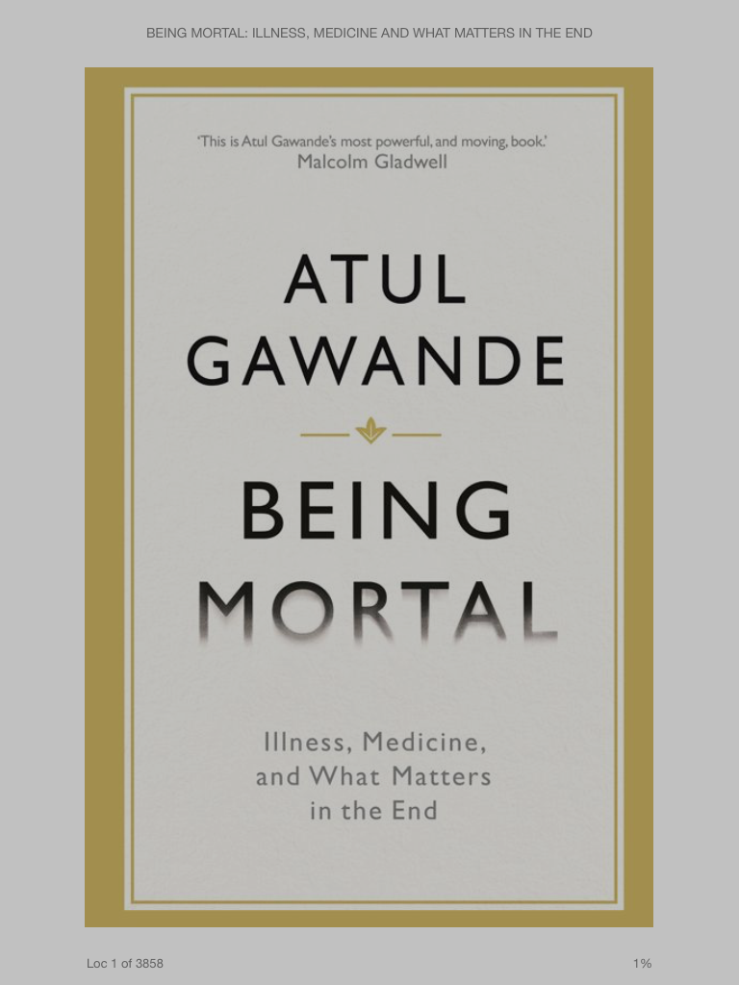
2010 New Yorker Article:
Letting Go:
What Should Medicine Do When It Can’t Save Your Life?

Slide 4
The changing nature of dying…
In 1945, the majority of people died at home after a short illness
By 1980, only 17% of people in the USA died at home
25% of health spending in the USA occurs for the 5% of people who are in their last year of life.
Most of the money spent on health care in Australia is spent during the last 30 days of our life (ABC RN Health Report)
Up to 30% of medical care may be futile (ABC RN Health Report)

Slide 5
Priorities for people at the end of their lives….
Avoiding suffering
Strengthening relationships with families and friends
Being mentally aware
Not being a burden on others
Achieving a sense that their life is complete

Slide 6
Social workers…..
Have an interest and concern with individual’s deepest and most deeply held fears risks and beliefs
Acknowledge the allocation of individual, family and societal resources
Recognise that goals of care may change
Have discussions around risk and benefit.
Take into account the social context

Slide 7
Social Work Roles Include:
Effective Communication and Advocacy
Bio-psycho-social assessment
Practical support
Counselling and emotional support
End of Life Preparation and Planning
Supporting families and Carers

Slide 8
Effective Communication and Advocacy
Gawande’s questions for all patients
What is your understanding of the situation and it’s potential outcomes?
What are your fears and what are your hopes?
What are the trade offs you are willing to make and not willing to make?
What is the course of action that best serves this understanding?

Slide 9
Bio-Psycho-Social Assessement
Social work assessments provide an outline of the patient’s
family dynamics
ethnic, religious and cultural background
experience of loss and change
attitude to illness and treatment options
need for practical help
need for emotional support and counselling
Assessments should be available to all members of the Renal Team

Slide 10
Community Support
Some of the organisations Social Workers Refer to:
IPTAAS Isolated Patient Travel and Accommodation Scheme
My Aged Care – Home Care, Respite Care, ACAT,
Centrelink
Community Transport Providers
Housing
Carer Respite Services
Electricity and Water Rebates
Community legal services
Enable (equipment)
Charities such as the Walter and Eliza Hall Survival Fund

Slide 11
Counselling and Emotional Support
Listening
Supporting
Counselling
Acknowledging spiritual and religious beliefs
The ‘dying role’
To share memories
To make peace with God
To ensure those left behind will be OK

Slide 12
End of Life Planning
70% of us die with other people having to make decisions for us about medical care
Advance Care Directives
Appointment of Enduring Guardian
Discussions between patients and families
Stanford Univ Study - 88% Doctors would chose conservative care if diagnosed with a terminal illness

Slide 13
Supporting Families and Carers
An essential part of the social work role
Facilitation of family meetings
Providing support to carers
Including families in decision making
Endings matter to those left behind

Slide 14
In Summary
We need to aim for a ‘good death’ – or (better still) a good life right until the end
Every patient has different life priorities which need to be listened to and respected
In end of life care, medical treatments should only be provided after a considered and consultative process
Social Workers are essential members of a multi-disciplanary renal teams!

