Slide 1
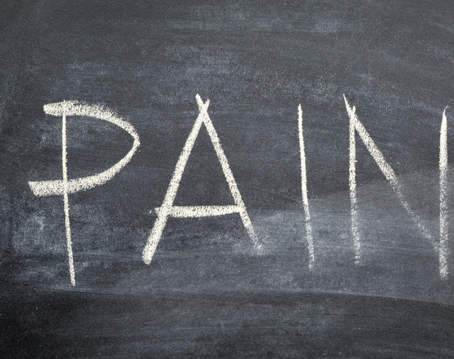
Pain
in ESKD

Slide 2
Pain is defined by the International Association for the Study of Pain as “an unpleasant sensory and emotional experience associated with actual or potential tissue damage or described in terms of such damage”.
Pain as a multidimensional phenomenon with physical and psychosocial components.

Slide 3
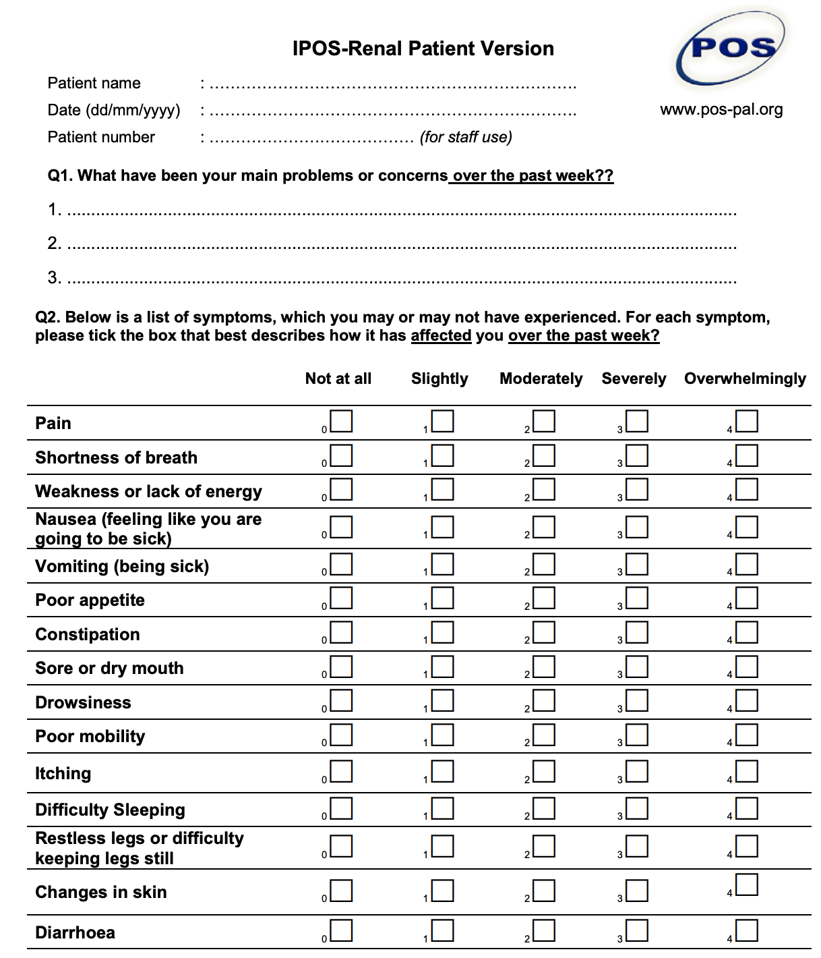
✔︎
✔︎
✔︎
✔︎
✔︎

Slide 4
Annette
74-year-old lady on PD
  Diabetic nephropathy – commenced PD end of 2022 in context of needing shoulder replacement surgery
  Background
    PE following shoulder surgery – on warfarin
    DM – PN, retinopathy & gastroparesis
    IHD
    Hypertension
    GOR
    Carpel tunnel syndrome – bilateral
    Depression

Slide 5
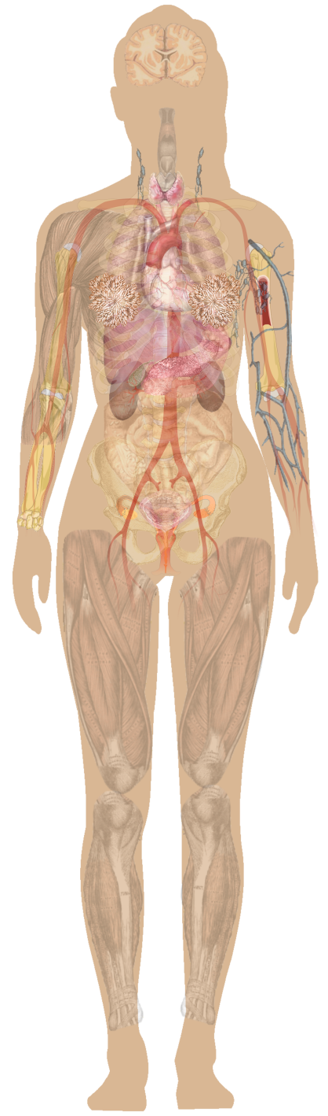
Effects of Chronic Uraemia
& Renal Failure
Psychological
Anxiety & depression
HD patients with chronic pain
・ MSK 59%
・ PN 40%
・ HD procedure 35%
・ Vascular 20%
CNS
Fatigue
Confusion
Headache
Co-morbid conditions
・Cardiovascular disease
・Ischaemic or diabetic neuropathy
・Osteoporosis
Haematological
Anaemia → fatigue & SOB
Platelet dysfunction → bleeding & bruising
Pulmonary
Pulmonary oedema
Uraemic Pleuritis
Gastrointestinal tract
Anorexia
Nausea & vomiting
Diarrhoea
Constipation
Cardiovascular
Hypertension
Heart Failure
Peripheral vascular disease
Pericarditis
Skin
Dry skin
Pruritus
Renal
Nocturia
Polyuria
Fluid retention
PCKD
Interventions
・ureteric stents
・IDC
Dialysis-related pain
・Muscle cramps
・Headaches
・Abdo pain (PD)
・Fistula & access
・Steal syndrome
Soft tissues
Calcification/calciphylaxis
Peripheral Nervous System
Paraesthesia/PN
Restless Legs Syndrome
Musculoskeletal
Renal Osteodystrophy
Bone pain
Notes:
3. Webster, Morton et al. Seminar – Chronic Kidney Disease. The Lancet 2017; 389: 1238-52.

Slide 6
Annette -
New Referral to KSC October 2022
Inpatient consult post shoulder surgery
Main issue peripheral neuropathy pain in both feet
  Amitriptyline dose reduced due to hypotension & pt getting inadequate pain relief
  Previously pregabalin ceased as caused distressing psychomimetic side effects -“made me go crazy”
  Endone associated with hallucinations in context of GA
Amitriptyline was ceased and duloxetine commenced at 30 mg daily
For follow up in KSC Clinic

Slide 7
The Scope of the Issue
Pain is common in patients with advanced CKD.
Over 58% of patients experience pain and approximately 49% of patients report moderate or severe pain, whether they are treated with dialysis or managed conservatively
Pain is associated with loss of function, psychologic distress, depressive disorders, limitations in work, family, and social life, decreased life satisfaction and QOL, increased hospitalizations and emergency department visits; and, for patients receiving HD, leads to shortened or missed treatments.
Pain that limits daily activities is associated with premature mortality with up to a 1.5-fold increase in mortality compared with patients with HDKF without chronic pain.
Pain is underrecognized and inadequately treated in patients with CKD
  In a prospective study of HD patients, 50% reported chronic pain; 75% of these patients self-reported suboptimal treatment of their pain
  75% of HD patients who report intense pain, and 35–75% of those who report moderate-to-severe pain, are not prescribed any analgesics

Slide 8
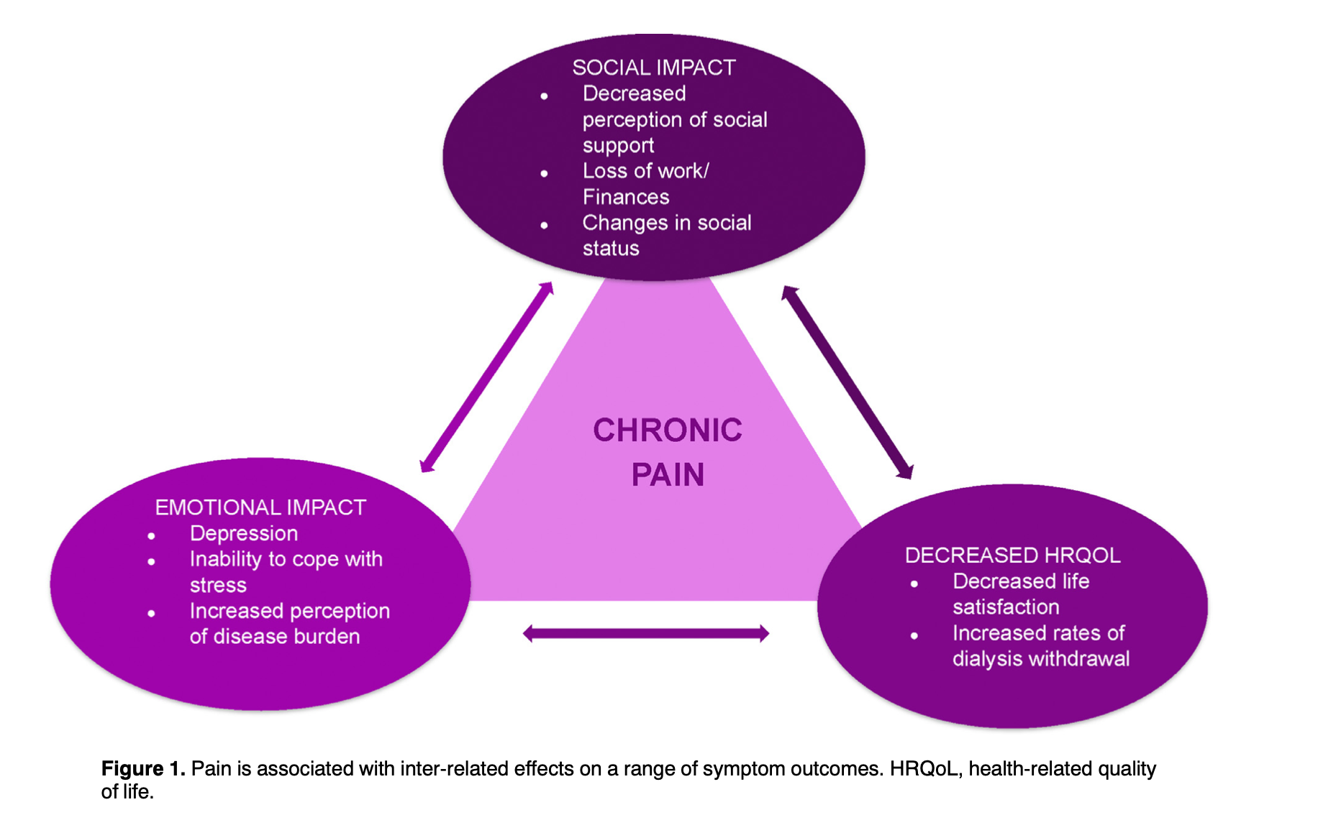
Ref 7.

Slide 9
Annette -
Progress in KSC Clinic
Reviewed every 3 months:
  Ongoing fatigue and SOB (issues with adequate PD)
  PN controlled on duloxetine 60 mg daily
  Annette reluctant to take over PD from husband
  Low mood – mirtazapine added at low dose by GP
  Ongoing ACP discussions but Annette unmotivated to complete ACD
Telehealth review in August (confusion in appointment)
  Husband raises concern for ‘new’ LBP for several months
  Limits her ability to stand and walk – using occasional paracetamol – Annette declining any investigation or stronger analgesia
  Recommendations – regular paracetamol and GP letter sent to reconsider imaging and low dose oxycodone if ongoing pain with reduce mobility.

Slide 10
Opioids in CKD
use is associated with adverse consequences.
  opioid use in maintenance dialysis patients has been associated with increased risk for death, dialysis discontinuation, hospitalisation, altered mental status, falls, and fractures in a dose-dependent manner
evidence for the effectiveness of opioids in pain management in patients with ESKD is lacking.
current opioid prescribing patterns are frequently inconsistent with guideline recommended care.
have altered efficacy and safety due to differential pharmacokinetics and dialysability, polypharmacy & drug-drug interactions.
In HD ESKD opioid use is associated with increased morbidity, mortality, and health-care resource utilization
  greater prevalence of falls, fractures, altered mental status, poor sleep and sexual dysfunction
  multifold increases in dialysis discontinuation & hospitalization
tolerance and physical dependence and opioid use disorder (OUD)
  Distinguishing OUD (“Addiction”) From Pseudoaddiction
  Pseudoaddiction is an iatrogenic syndrome characterised by behaviours that mimic OUD but occur in the setting of inadequately treated pain.

Slide 11
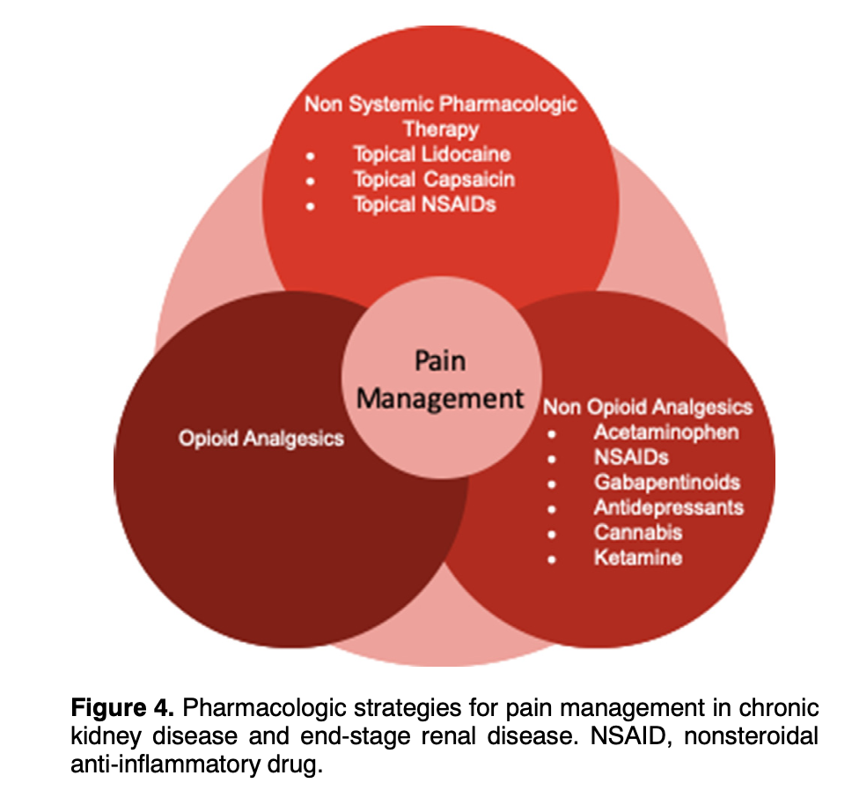
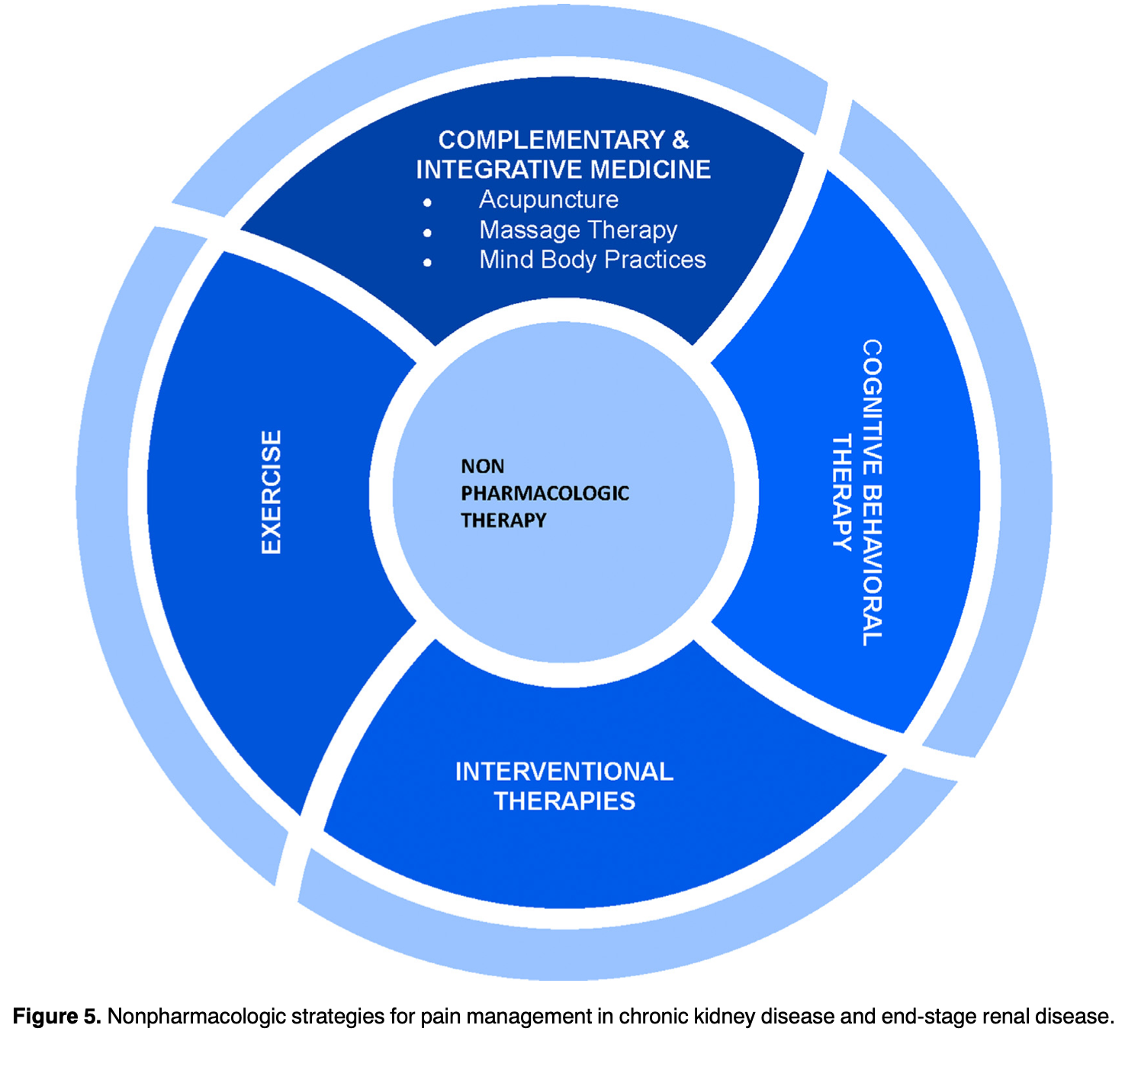
Return to holistic pain management, where improved function and wellbeing are target outcomes, and non-pharmacological modalities & non-opioid pharmacotherapies form part of multimodal therapy
Ref 7

Slide 12
Key Considerations in the Evaluation of Pain to Guide Pharmacologic Management
Evaluation of pain requires a comprehensive patient assessment and physical examination that includes:
  understanding the patient’s diagnosis and medical history
  determining the effects of the pain on the patient’s psychologic status, social functioning and QOL
  Clarify the impact of pain on functional status
    marker in the evaluation of the pain experience and response to therapy
  Clarify prognosis & anticipated illness trajectory
    may affect the focus of treatment and appropriateness of opioid therapy
  Evaluate previous approaches to pain management
    assess whether nonpharmacologic and other pharmacologic (nonopioid/ adjuvant) strategies have been appropriately exhausted
  Discuss/evaluate for risks vs benefits of opioid treatment
Four aspects of the evaluation essential to determining a pharmacologic approach are determining:
  pain intensity
  chronicity and possible reversible causes for the pain
  the type of pain—nociceptive, neuropathic, or combined
  treatment goals.
Functional status is an important marker in the evaluation of the pain experience and response to therapy
BONUS OUTCOME: realistic goals
Ref 1 & 2
BONUS EFFECT: patient is heard

Slide 13
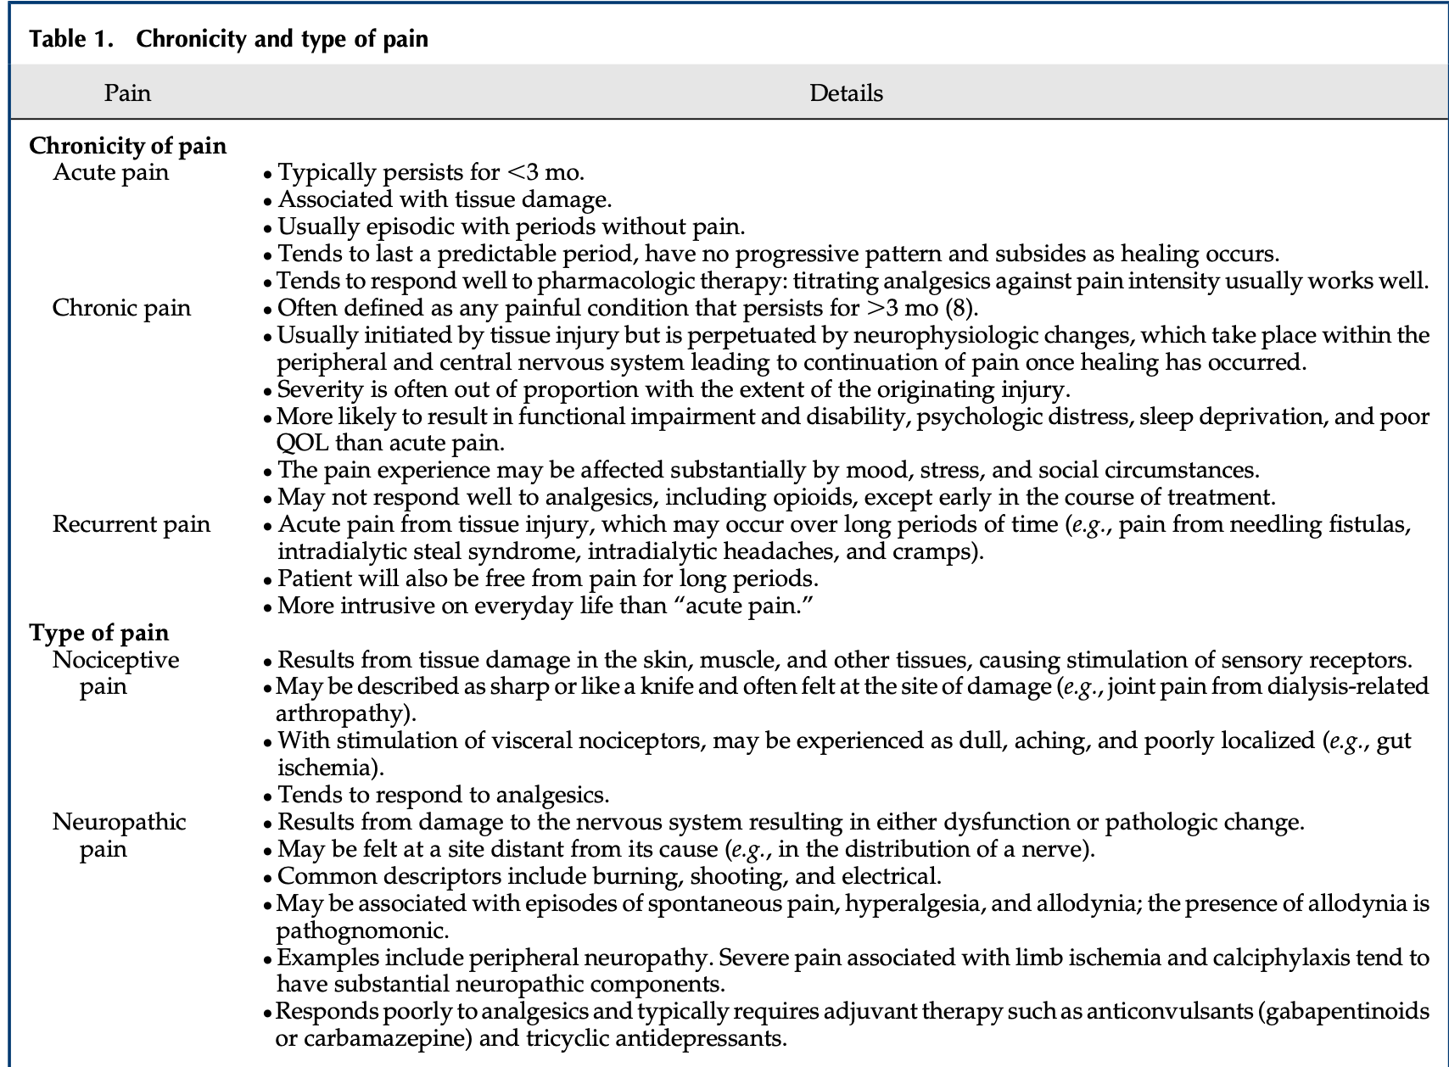
Ref 1.

Slide 14
Annette -
KSC Clinic this Thursday
Annette and husband FTF review
  Priority for both is clearly LBP “we know this is not her most serious medical issue but it is the one causing most distress – we know you’re the renal team but please help with the pain as no one else is”
  LBP – lumbar & paraspinal – no radiation or neuropathic features – worse on standing & walking with reduce mobility, function & enjoyable activities.
  Analgesia – Panadol osteo 1 bd
  CT scan 3 days ago –
    Bilateral facet joint arthropathy most severe L4/5 & L5/S1. At L4/5 moderate canal stenosis with possible irritation of L5 nerve root at lateral recess. Mod to severe foraminal stenosis bilaterally at L5/S1
  Medications – duloxetine 60 mg, mirtazapine 15 mg, warfarin 1 mg, aspirin, metoprolol, statin, thyroxine, EPO, insulin
  Impression – lumbar spine pain most consistent with degenerative arthropathy of facet joints

Slide 15
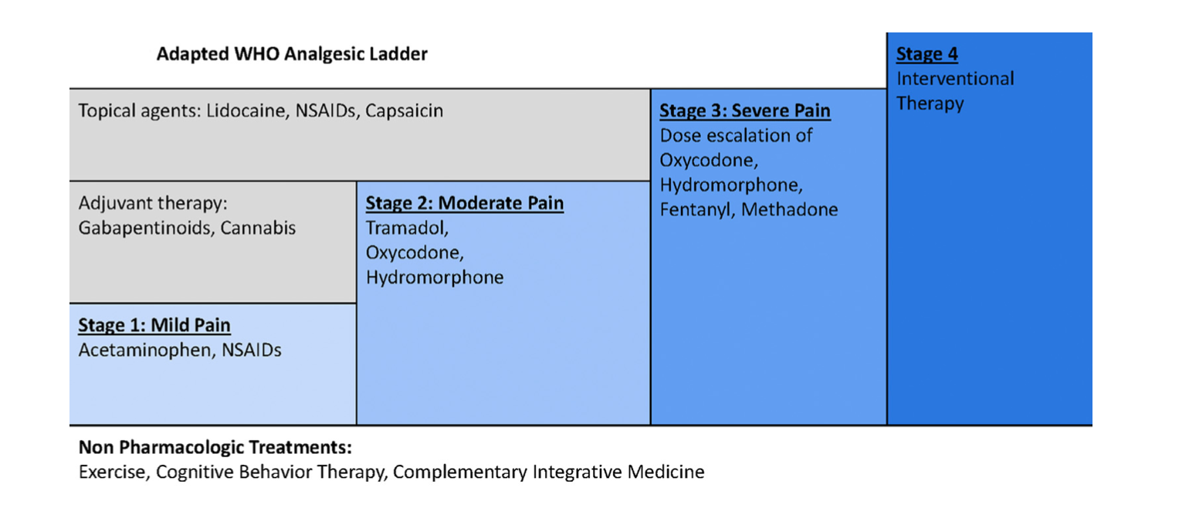
Adapted WHO Analgesic Ladder for Pain Management in CKD
・widely recommended for pain management in CKD
・validated in ESRD patients receiving HD but not shown to be effective for pain management in elderly ESRD patients receiving HD
・strategy recommended in KDIGO guidelines in advanced CKD and palliative care settings
Ref 7.

Slide 16

Nonopioids
Paracetamol
  antipyretic analgesic with weak anti-inflammatory activity
  metabolized extensively in the liver.
  2%–5% of the dose is excreted unchanged in the urine and there are no clinically significant changes observed in patients with kidney failure
  evidence suggests that lifetime cumulative doses of paracetamol do not have an adverse effect on CKD progression rate

Slide 17
Nonopioids
NSAIDs
  The major limitation is gastrointestinal toxicity → ulceration & bleeding
  Nephrotoxic effects
    Reduction in eGFR
    Sodium & water retention → hypertension, volume overload & hyperkalaemia
  cardiovascular adverse effects
    myocardial infarction, thrombotic events, and stroke
  COX-2 inhibitors have better GI toxicity profile
  elderly at increased risk for NSAIDs-associated psychiatric events
    agitation, depression, anxiety, paranoia, delirium, and hallucinations.
  Acute pain
    Use best reserved for specific indications limiting their use to the lowest effective dose and shortest duration
    Avoiding the use of NSAIDs is associated with increased opioid use to control pain
  Topical NSAIDs
    can provide effective pain relief without the systemic adverse events associated with oral NSAIDs when used for both acute and chronic pain
  CONSIDER - although NSAIDs have been associated with adverse effects they can still be used in patients with HDKF — at the lowest effective doses and for short periods — if patients and providers are willing to accept these risks

Slide 18
The Opioids…..

Slide 19
Opioid Metabolism and Advanced CKD
Patients with kidney failure are at increased risk for adverse effects of opioids due to reduced elimination and increased accumulation of the parent analgesic and/or active metabolites.
Analgesics may also be removed by dialysis, leading to uncertain analgesic effects during treatment.
Opioid metabolism takes place primarily in the liver, with the metabolites (and varying degrees of the parent drug) excreted by the kidneys.
Opioid metabolism results in the production of both inactive and active metabolites, some of which may be more potent than the parent compound. These will accumulate to various degrees in patients with decreased kidney function and patients tend to have a narrow therapeutic window between analgesia and toxicity
Careful selection of opioids is essential

Slide 20
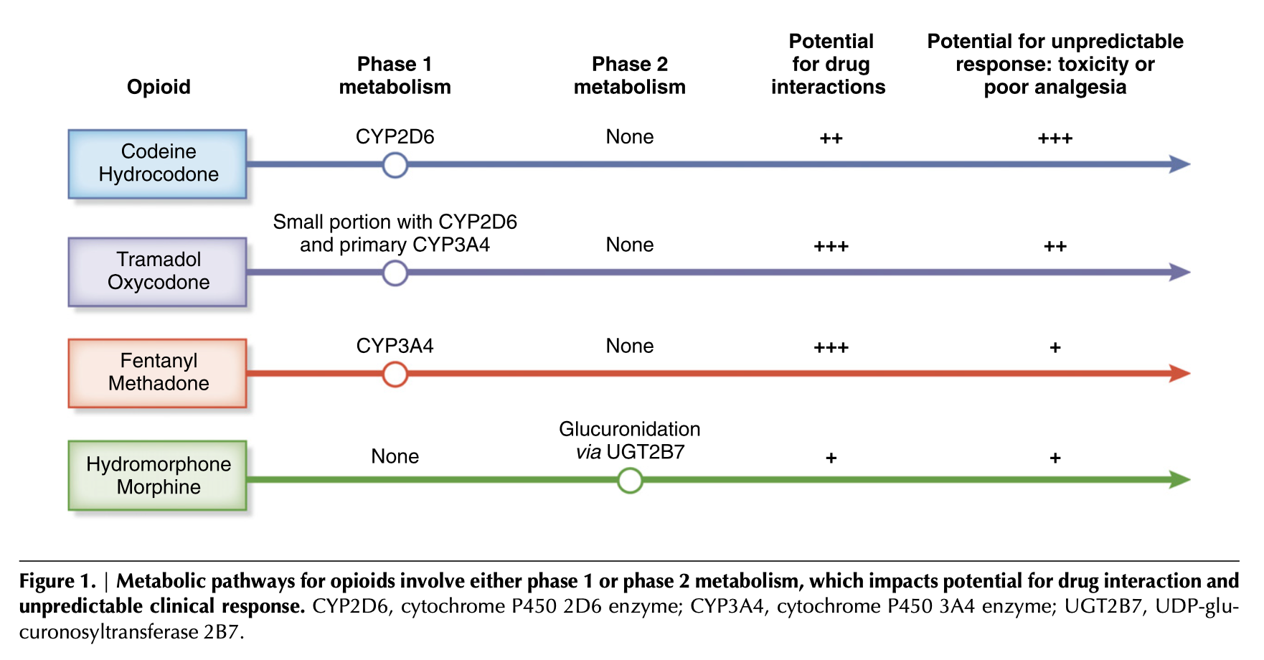
Opioid Metabolism
CYP2D6 gene - genetic polymorphism → individual response highly variable with toxicity & poor analgesic response both possible
CYP2D6 enzyme - metabolises 25 % drugs
CYP3A4 enzyme - metabolizes 50% of drugs so a high risk of drug-drug interactions
Phase 2 glucuronidation
・minimal drug interaction potential
Buprenorphine
Tapentadol
Ref 1.

Slide 21
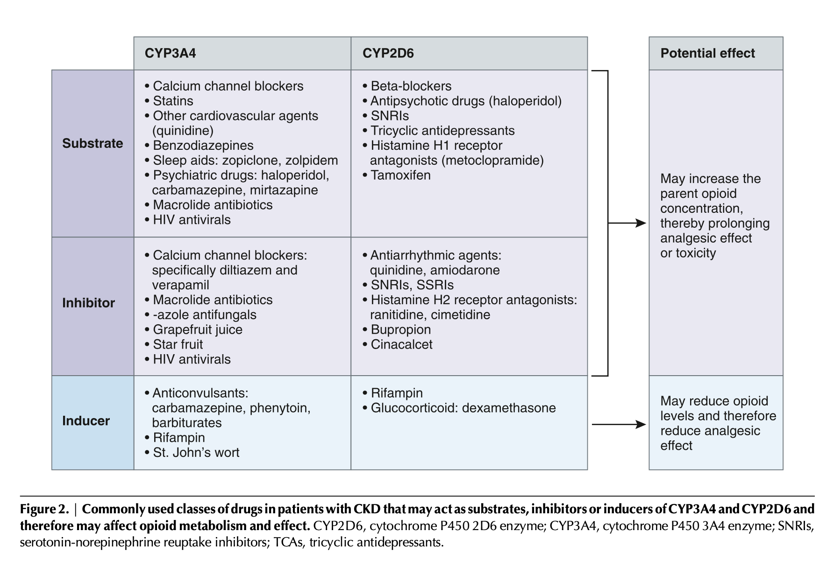
Polypharmacy…
And QT prolongation
Ref 1.

Slide 22
Effect of Dialysis
Stability of analgesia during dialysis will vary depending on dialysability of the opioid
Opioids that are well dialysed may require supplemental dosing during or after HD and patients could be at higher risk for opioid withdrawal symptoms after dialysis
Opioids that are not well dialysed will have more stable analgesia
  However, if there is accumulation of the parent drug and/or active metabolites, the risk for toxicity increases.
Factors that promote dialysability include:
  lower molecular weight
  lower protein binding,
  greater water solubility, and
  lower volume of distribution.

Slide 23
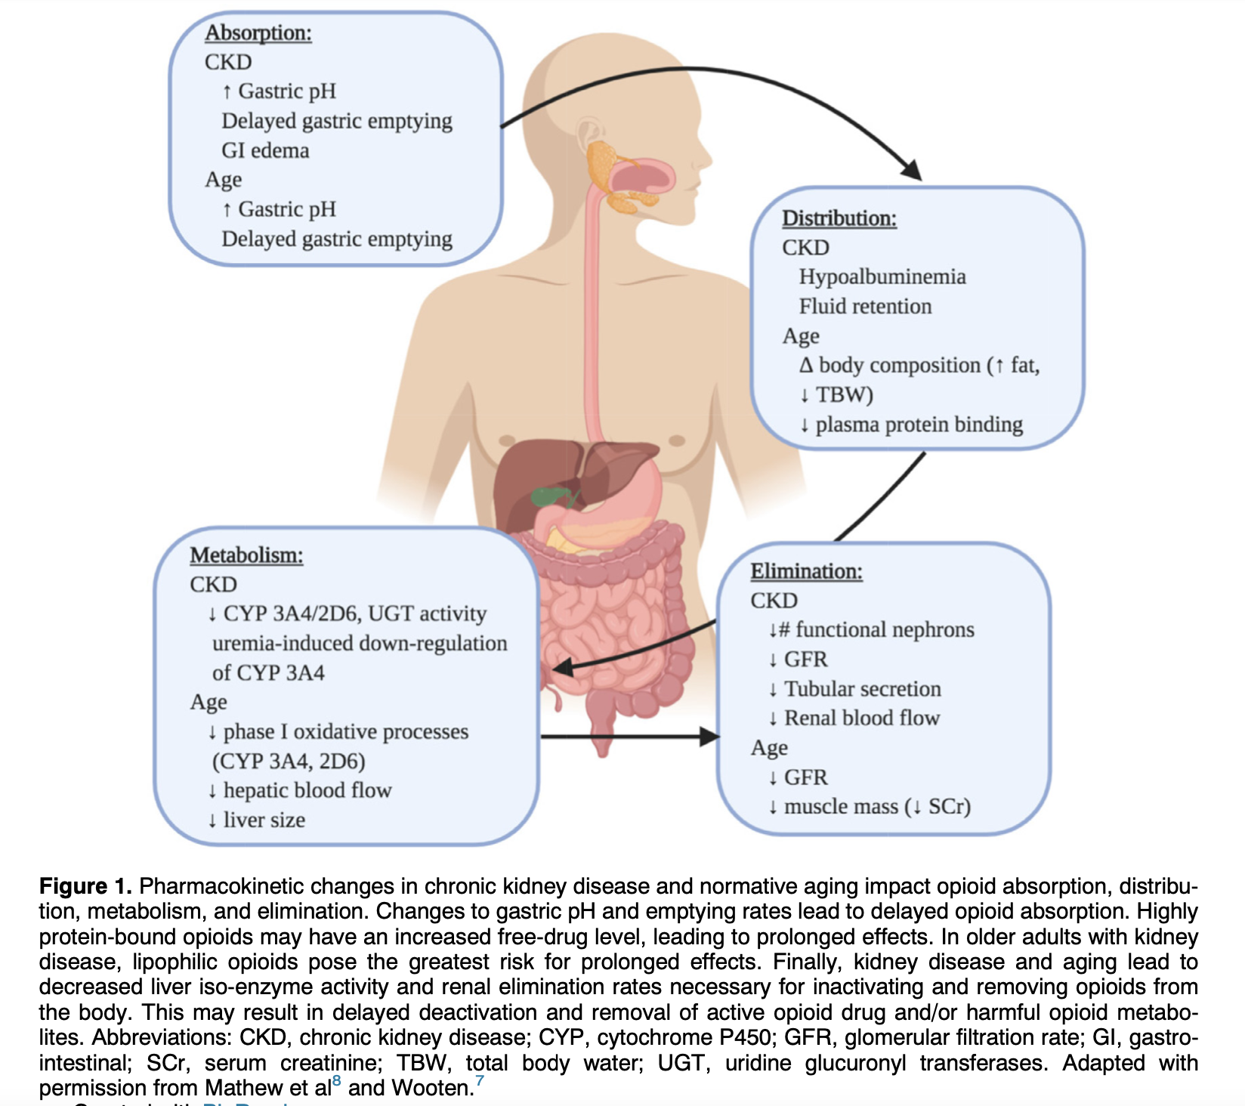
And then add in Aging…
Ref 6.

Slide 24
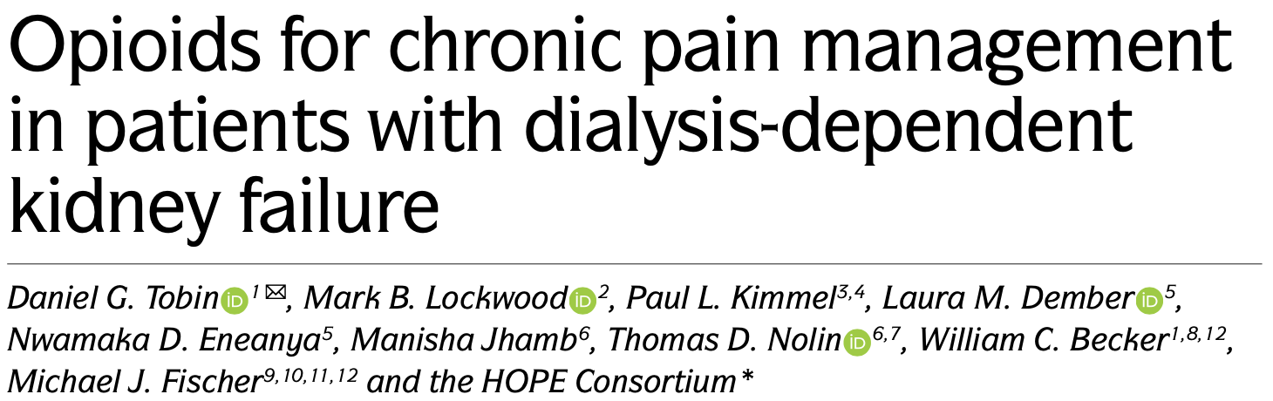

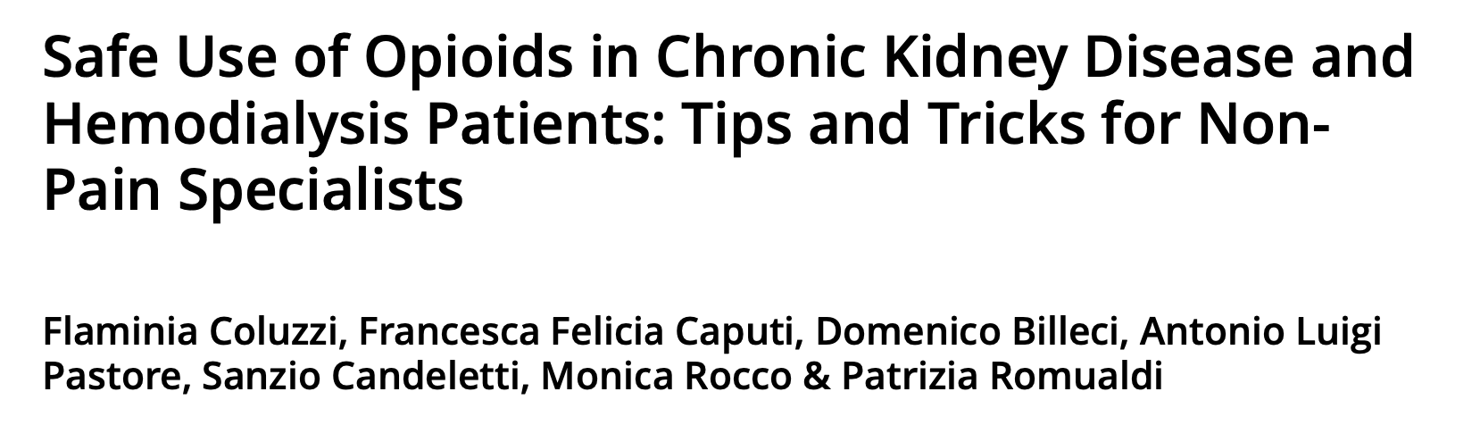
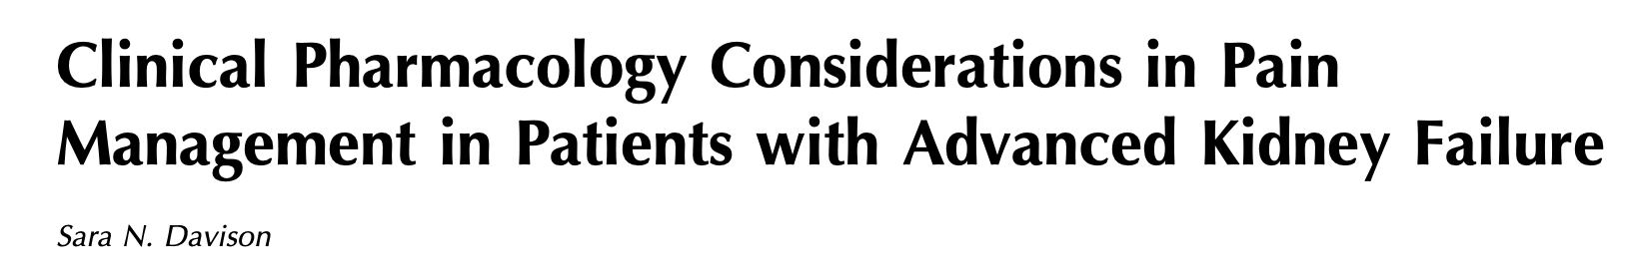
Welcome to the family!
Number of journal articles of tables of opioids wrt use in CKD and ESKD

Slide 25
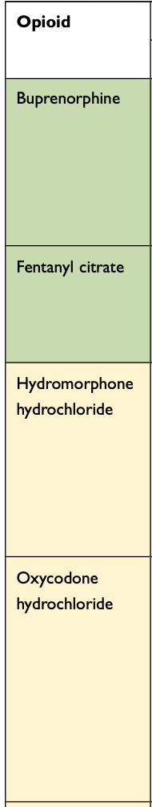
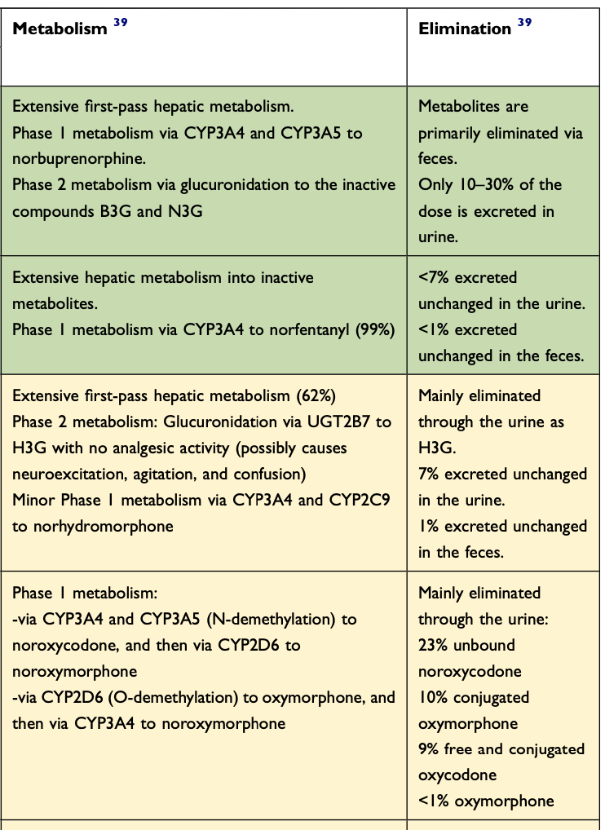
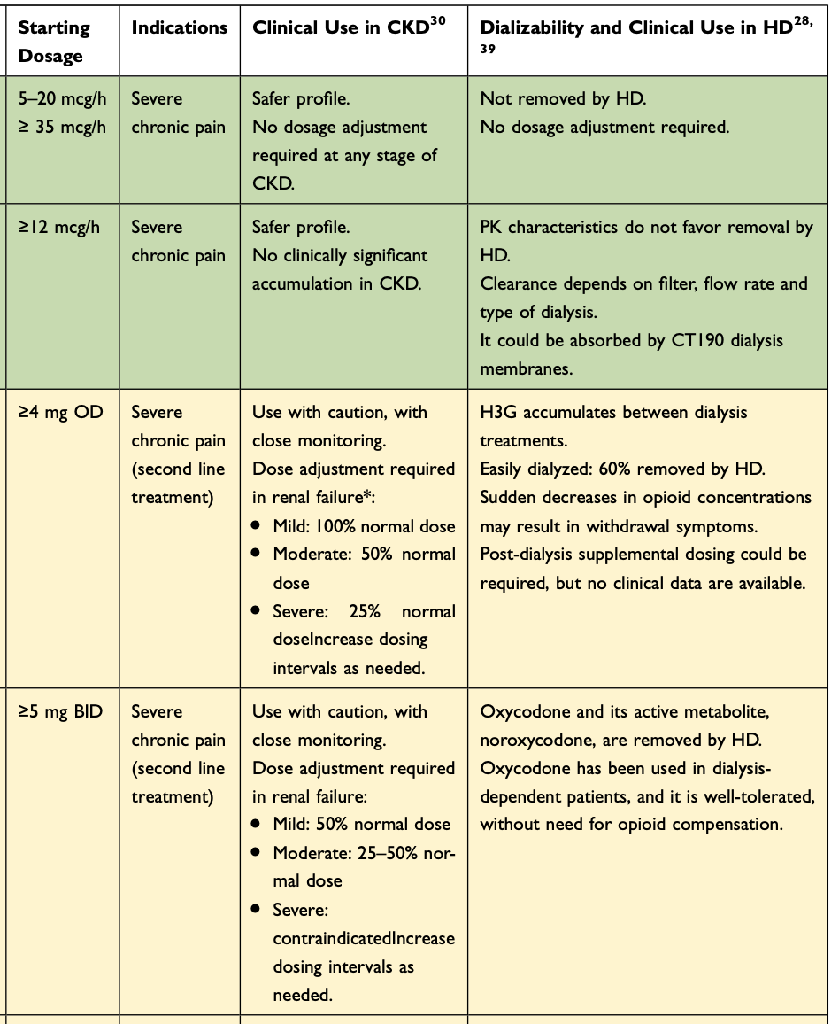
x
0.5 – 1 mg qid
x
2.5 mg qid

Slide 26
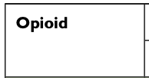
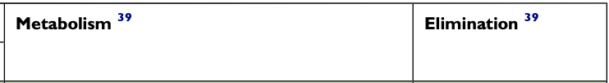
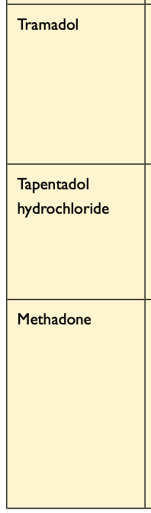
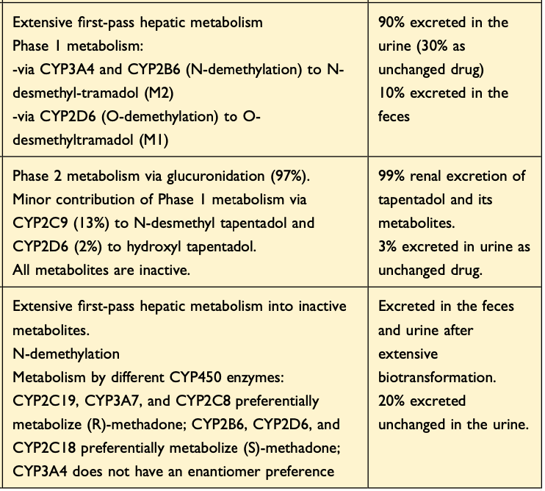
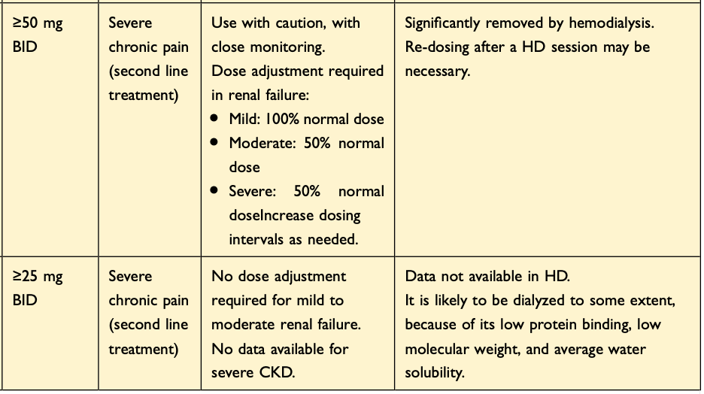
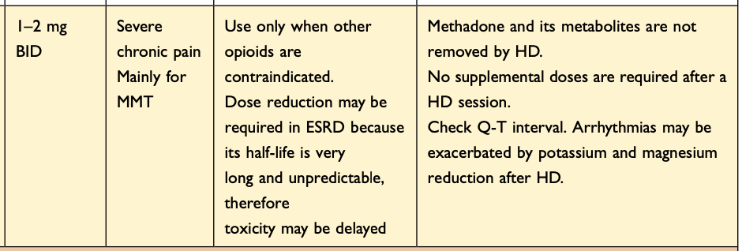
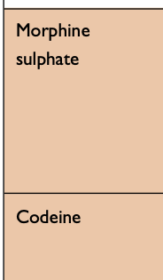
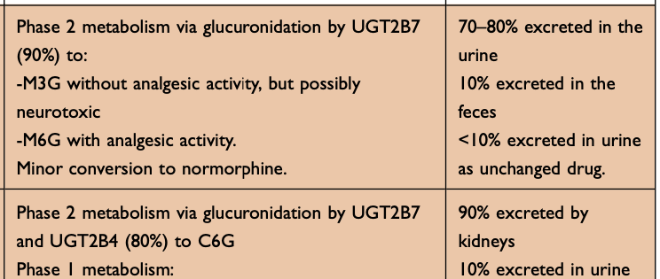
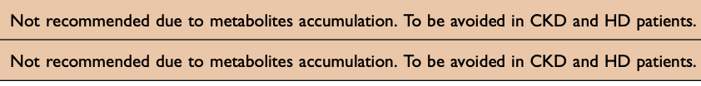
Ref 8.

Slide 27
Buprenorphine
emerging as a viable option to treat pain in ESKD, especially in patients with medical comorbidities that place them at an above-average risk of opioid toxicity
non-selective mixed agonist–antagonist opioid receptor modulator — it functions as a partial opioid agonist on the μ-opioid receptor, and as an opioid antagonist on the κ-opioid and δ-opioid receptors
partial μ-agonist effects are the most widely studied aspect of the favourable safety profile of buprenorphine, but its antagonistic effects on the δ-opioid and κ-opioid receptors might also decrease the risk of constipation and might have anti-depressant and anti-anxiety effects
risk of respiratory depression is substantially lower than that of full agonist opioids. However, concomitant use of benzodiazepines, alcohol or other CNS depressants accentuates this risk.
QTc prolongation potential.
  But the number of cases and frequency of all adverse event cases associated with methadone tenfold higher
risk of precipitated withdrawal exists when an opioid-tolerant individual with recent use of full agonist opioids switches to a therapeutic dose of buprenorphine
Buprenorphine and two-thirds of its metabolites are excreted via the gastrointestinal tract, which minimizes its accumulation and toxicity in patients with impaired kidney excretion
Buprenorphine is a drug with a large volume of distribution and high protein-binding capacity (>90%), and might therefore not be removed substantially during HD
Ref 3.

Slide 28
Where does this leave opioids in CKD?
When pain experienced at the end-of-life merits the use of opioids, the consensus is that dosing should be proportionate to the level of pain and should be neither withheld nor under-prescribed
Despite the relative absence of evidence, the expectation that opioids for chronic pain provides a clinically meaningful improvement in pain and function in some patients seems reasonable.
The potential risks and benefits of opioid use in an individual patient are dynamic and can be difficult to assess, to reduce risk:
  using the lowest effective dose, exercising caution when escalating doses and avoiding high-dose opioids
  when prescribing opioids to an opioid-naive patient without tolerance, extended-release or long-acting formulations should be avoided
  a deliberate and measured approach to starting opioid therapy and frequently reassess appropriateness and safety.
Initial therapeutic opioid use should be framed as a trial and not a commitment to ongoing opioid prescribing
The response of individual patients might be difficult to predict, so some trial and error might be required before identifying the best drug

Slide 29
STEP 2:
Oxycodone
Buprenorphine
Hydromorphone
Fentanyl
Tapentadol
Methadone
STEP 1:
Paracetamol, NSAIDs
Adjuvant therapy – gabapentinoids, TCAs, SNRIs
Topical therapy – NSAIDs, lignocaine, capsaicin
Interventional therapy – joint injections, nerve blocks, nerve root injections
Non pharmalogical treatments – exercise, CBT, massage

Slide 30
Adjuvant analgesics – Neuropathic Pain
Treatment follows the guidelines for management of neuropathic pain in the general population
Special consideration in patients with CKD for abnormal clearance and potential adverse effects
First line agents include gabapentinoids, tricyclic antidepressants, and serotonin and norepinephrine reuptake inhibitors
Gabapentin and pregabalin have been specifically evaluated in patients with ESRD and are preferred
  Evidence that they improve symptoms of pain, depression, and subjective sleep and quality-of-life scores
  shown to be useful in treating restless legs syndrome and uremic pruritis
Tricyclic antidepressants are more effective in treating neuropathic pain than serotonin and norepinephrine reuptake inhibitors
  anticholinergic, histaminergic, and adrenergic side effects resulting in symptoms such as dry mouth, orthostatic hypotension, and somnolence can limit use
Serotonin and norepinephrine reuptake inhibitors, such as venlafaxine and duloxetine
  tend to be less effective than anticonvulsants and tricyclic antidepressants but have fewer adverse effects have
  limited safety evidence in CKD
  varying recommendations for use and dosing in CKD;
  doses should start low with slow titration and close monitoring for adverse effects

Slide 31
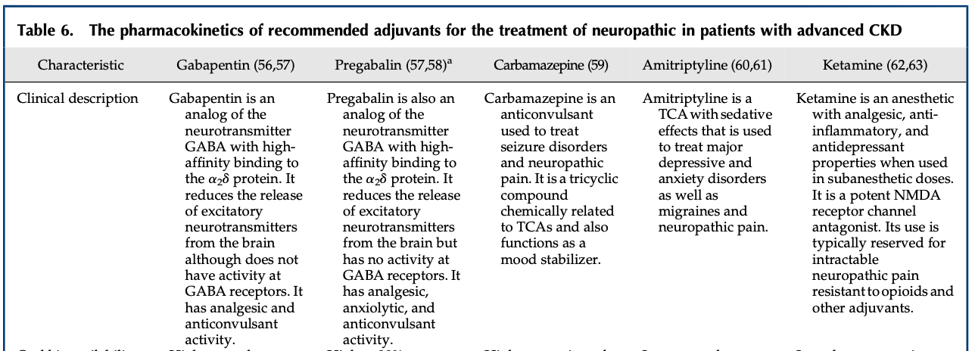
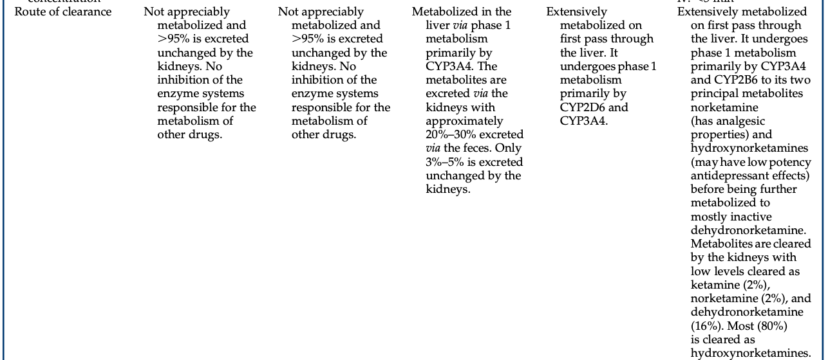
2018 US study of adults receiving haemodialysis:
Gabapentin and pregabalin were associated with risk of altered mental status, fall, and fracture in a largely dose-dependent manner and in some cases, even at levels of dosing considered safe by guidelines.
Ref 1 & 5.

Slide 32
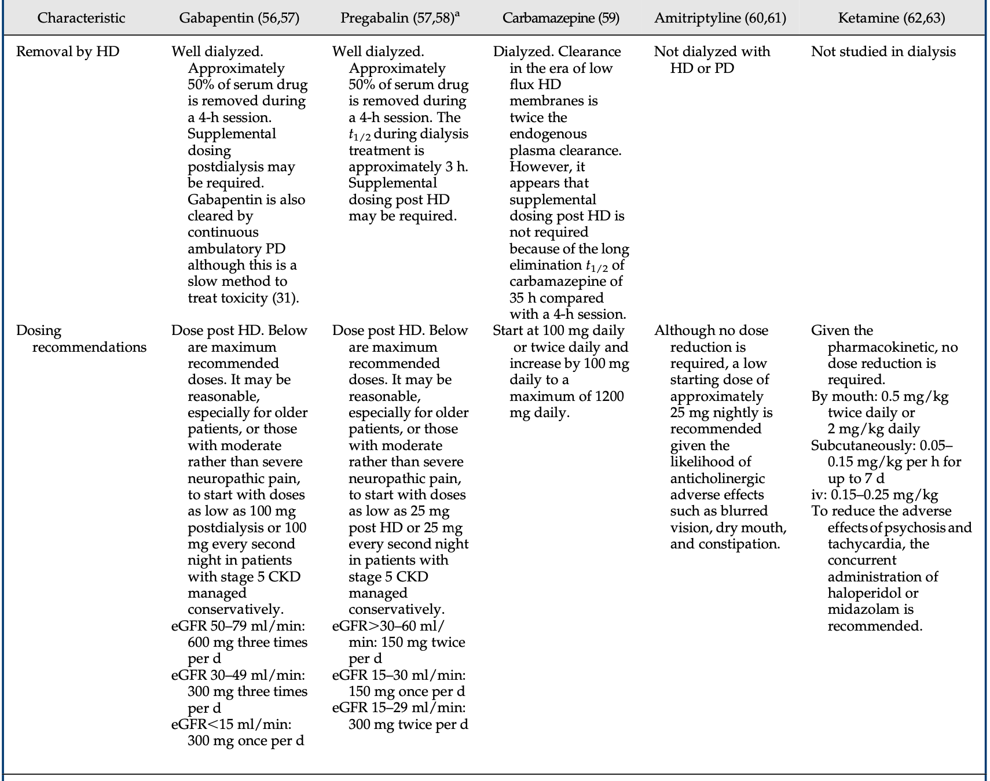
Emerging research has also demonstrated that combining opioids with GABAergic medications (that is, medications that affect the action of γ-aminobutyric acid), such as gabapentin and pregabalin also increases the risk of opioid overdose, especially in patients with HDKF (Ref 3)
Ref 1 & 3.

Slide 33
Return to holistic pain management, where improved function and wellbeing are target outcomes, and non-pharmacological modalities & non-opioid pharmacotherapies form part of multimodal therapy

Slide 34
the need for systemic NSAIDs has been shown to be reduced by 40% with the use of topical NSAIDs
Capsaicin cream or patches can be used for treatment of peripheral neuropathy
Ketamine & cannabinoids -evidence for use in kidney disease continues to be lacking and therefore it cannot be recommended for use at this time

Slide 35
Acupuncture has evidence in chronic LBP in non CKD
Massage- LBP & shoulder pain in general pop.
Intradialytic muscle cramps some evidence.
modalities such as music therapy have been used for patients with ESRD receiving HD and shown decreased pain and anxiety experienced during HD sessions
Evidence for most of these strategies is limited generally – even more so in CKD & ESKD
However, they carry a relatively low risk of adverse effects and potentially little downside; except for some interventional therapies.
Interventional therapies:
LBP - injection therapy such as facet joint, nerve root & epidural injections.
Genicular nerve block for knee pain.
Other joint injections
CBT - systematic reviews in chronic pain have shown modest positive effects on pain and mood in non CKD.
Few studies in CKD but still some positive findings reported.
Evidence for exercise therapy in patients with kidney disease has been largely positive, and data are more robust for exercise than for other nonpharmacologic strategies – studies have shown reduced pain, improved functioning as well as reduced depressive symptoms, better sleep quality, and higher HRQoL. Reduced muscle spasm have also been reported.

Slide 36
Current plan for Annette
Discussion with Annette & husband
  Explanation of likely cause of pain
  Aim of management to improve function – help pain become manageable
  Analgesic explained – prioritizing/maximising nonopioids and topical agents
  Opioids discussed – risks and benefits – common side effects
Panadol osteo 2 tabs tds
Topical NSAIDs
Low dose oxycodone IR
Check on progress in 1 week
CT to be reviewed at Radiology meeting to consider facet joint injections

Slide 37
References
Davison, S. N. (2019). Clinical pharmacology considerations in pain management in patients with advanced kidney failure. Clinical Journal of the American Society of Nephrology, 14(6), 917-931.
Lu, E., Schell, J. O., & Koncicki, H. M. (2021). Opioid Management in CKD. American Journal of Kidney Diseases, 77(5), 786-795.
Tobin, D. G., Lockwood, M. B., Kimmel, P. L., Dember, L. M., Eneanya, N. D., Jhamb, M., ... & HOPE Consortium. (2022). Opioids for chronic pain management in patients with dialysis-dependent kidney failure. Nature Reviews Nephrology, 18(2), 113-128.
Koncicki, H. M., Unruh, M., & Schell, J. O. (2017). Pain management in CKD: a guide for nephrology providers. American journal of kidney diseases, 69(3), 451-460.
Ishida, J. H., McCulloch, C. E., Steinman, M. A., Grimes, B. A., & Johansen, K. L. (2018). Gabapentin and pregabalin use and association with adverse outcomes among hemodialysis patients. Journal of the American Society of Nephrology: JASN, 29(7), 1970 -1978.
Hawley, C. E., Hickey, E., & Triantafylidis, L. K. (2021, January). Pharmacologic Considerations for Opioid Use in Kidney Disease. In Seminars in Nephrology (Vol. 41, No. 1, pp. 2-10). WB Saunders.
Lu, E., & Koncicki, H. M. (2021, January). Nonopioid Approaches to Pain Management in Chronic Kidney Disease. In Seminars in Nephrology (Vol. 41, No. 1, pp. 54-67). WB Saunders.
Coluzzi, F., Caputi, F. F., Billeci, D., Pastore, A. L., Candeletti, S., Rocco, M., & Romualdi, P. (2020). Safe use of opioids in chronic kidney disease and hemodialysis patients: tips and tricks for non-pain specialists. Therapeutics and Clinical Risk Management, 821-837

