Slide 1

Advance Care Planning in the Auckland District Health Board Renal Department
Elizabeth Stallworthy
Nephrologist
August 2015

Slide 2
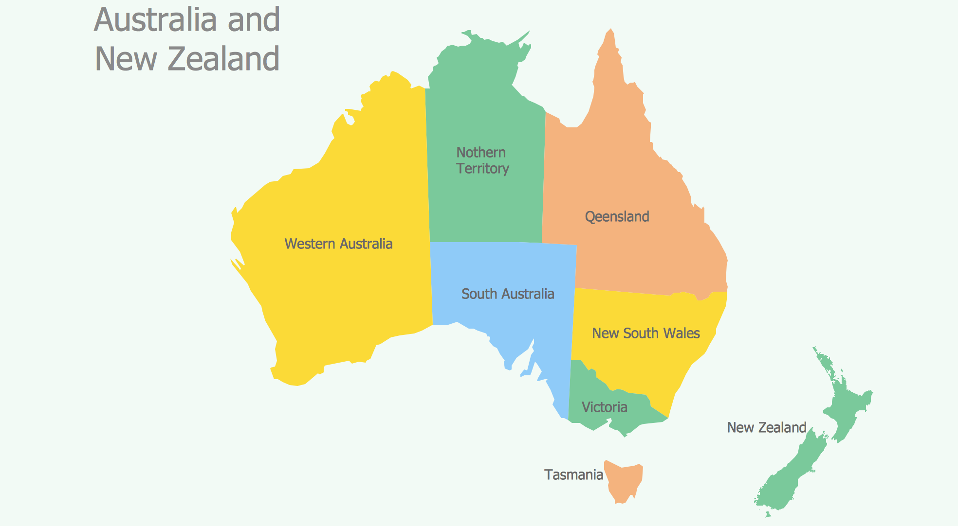
Where is Auckland?
Northern Territory
Queensland

Slide 3

New Zealand Advance Care Planning Co-operative
Established June 2010
Key priorities are:
  Public engagement and education
  Staff training in advance care planning and communication skills
  Consistent language and documentation
  Cultural appropriateness
Funding from NRA and Health Workforce NZ for the development and roll out of the training programme

Slide 4
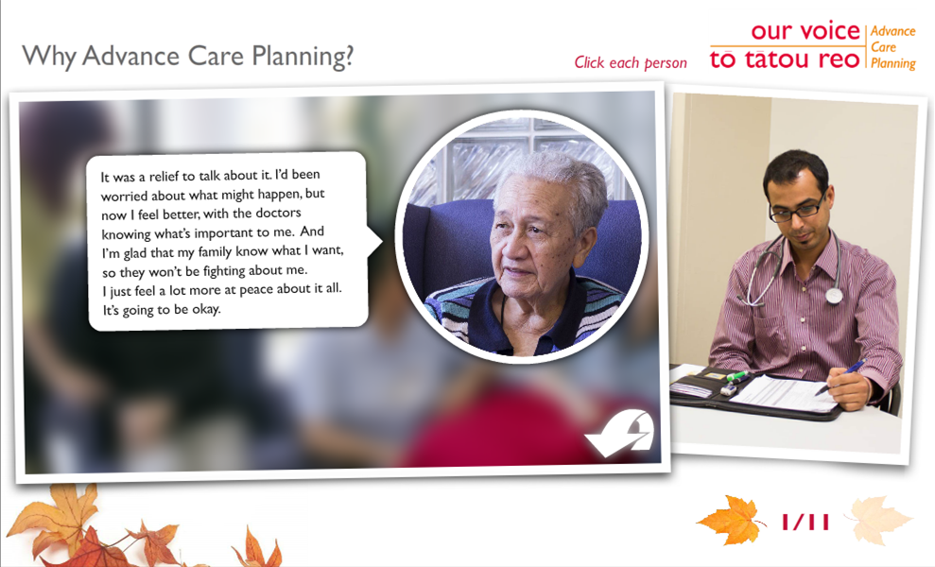
National ACP Training for Healthcare Professionals
Image used with permission of NZ National Advance Care Planning Training Programme
Notes:
Level 1 ACP e-learning 4 modules
Available to all online www.advancecareplanning.org.nz
Consider advance care planning: involves writing ones own ACP
Talking about advance care planning: looks at barriers to conversations, openers, how to finish conversations
Changing outcomes: looks at how ACP can change decision making in clinical practice and the legal framework around decision making when the patient doesn’t have capacity in NZ
Clarifying advance care planning process: asks participant to reflect on ACP processes in their organisation
Takes 10-30 minutes to complete each one

Slide 5



L2 ACP Communication Skills course structure
3 step training course
STEP 3– Consolidating ACP process
Using learned skills to have ACP conversations
Becoming an ACP ambassador
STEP 2 - ACP Communication Skills Workshop
10 participants, 2 L3 Facilitators
  Communication skills theory
  Experiential learning in a safe environment
  Developing skills to deliver ACP conversations
STEP 1 – Preparation
Completing E-Learning modules (L1)
Pre-reading
  Contemplation & self-awareness
Slide sourced from NZ National Advance Care Planning Training Programme
Notes:
Level 2 ACP practitioner training
Based on UK Connected communication skills training course
Most delegates funded by their DHB
864 trained to date
Good communication skills
EMPATHY
ACTIVE LISTENING
ABILITY TO PICK UP AND EXPLORE CUES
Awareness of behaviours that inhibit patients sharing their thoughts with us

Slide 6
Level 2 delegates by role
Data supplied by the NZ National Advance Care Planning Training Programme

Slide 7
Facilitator (L3)
not necessarily content expert
expertise in group dynamics
helps group define own outcomes and how to achieve these
aims to help group achieve broad organisational goals
Trainer (L4)
content expert
expertise not in group dynamics
develops methods to help achieve specific learning objectives defined by training needs analysis
aims to change practice
Slide sourced from NZ National Advance Care Planning Training Programme

Slide 8

Public Awareness Campaigns
Image used with permission of NZ National Advance Care Planning Training Programme
Notes:
Public engagement and education
Discuss Conversations that Count day

Slide 9

The Programme aims to …
“… encourage families and communities to think and talk about the treatment and care they want at the end-of-life”
This is done by training volunteers to be Communicators
Slide sourced from NZ National Advance Care Planning Conversations that Count Programme

Slide 10
ACP in Auckland DHB
National program office based at Auckland Hospital
Senior clinical staff engaged with ACP
  National clinical leader for program is one of our senior physicians in management at ADHB
ACP project manager provides resources for Level 2 Facilitators
ACP policy for our organisation states that ACP should be offered to all patients

Slide 11
ADHB Nephrology
Tertiary referral hospital
  Secondary care general nephrology
  Tertiary/quaternary referral centre for renal transplant
9 Nephrologists
335 dialysis patients
Home, self care, assisted self care, dependent care and in hospital dialysis
Supportive care clinic

Slide 12
ACP Leadership in ADHB Nephrology
Hospital management
Nephrology Clinical Director
Charge Nurse Manager
  “MOS board” goal in dependent care dialysis units
ACP Level 3 Facilitator
ACP Level 2 Practitioner trained physicians, nurses, social worker (7 in total)

Slide 13
Why do I practice ACP?
In my observation ACP improves outcomes for
  Patients
  Families/significant others
  Healthcare practitioners
In my opinion the biggest barrier is healthcare professionals not knowing how to have the conversation

Slide 14
How do I practice ACP?

Slide 15
Conversations (context)
AD
ACP
Slide adapted from NZ National Advance Care Planning Training Programme
Notes:
Conversations and shared understanding of diagnosis, prognosis and patient goals and treatment options between family, patient and HCP are key objectives of ACP.
Documents are very much secondary, particularly AD.

Slide 16
ACP in Supportive Care
People want to maximise their quality of life
  Who are their support people?
  What are their goals?
  What are their frustrations/fears?
    POS-S renal
  What are they prepared to do to achieve goals and reduce frustrations?
Notes:
I try to focus some of the conversation on what we can achieve for the patient and their family

Slide 17
ACP in Supportive Care
End-of-life care plan
  Who will look after the patient?
    Family/support people (do they know?)
    Paid carers
  Where will they be looked after?
    Own home
    Family/support person home
    Residential care
  Expert medical advice for patient/carers/GP
  I don’t routinely explicitly discuss resuscitation status
Notes:
Specific,

Slide 18
Belinda and Danny
Notes:
Belinda and Danny are the daughter-in-law and son of an elderly woman I looked after in my Supportive Care Clinic earlier this year. Their mother came to my clinic in September 2014 and then January 2015.

Slide 19
ACP in dying dialysis patient
Who are their support people?
What are their goals before death?
  Risk-benefit
What are their fears about dying?
Where do they want to die?
When and how are we going to decide to stop dialysis?
Discussion of resuscitation status
Latter two may lend themselves to AD
Notes:
Dying dialysis patient scenario has many similarities to conservatively managed CKD in that, once there is a shared understanding of the diagnosis and prognosis there is a clear expectation of deteriorating health. The main difference I find is that because dialysis patient’s lives are more “medicalised” there needs to be more discussion about medical treatments and when to stop or not start treatments like dialysis and CPR.

Slide 20
ACP in stable dialysis patient
Acknowledge emotion/unpleasantness of topic
Who are their support people?
Is there anything they would like observed if they were very unwell?
  Religious, cultural, family
Do they have any thoughts about end-of-life care?
Do they have any strong preferences about medical treatments?
  Dialysis discontinuation, CPR
Notes:
Challenge is the need to have the conversation without leaving the patient feeling that there is something I am not telling them.

Slide 21
ACP in person with CKD
Acknowledge emotion/unpleasantness of topic
Who are their support people?
Is there anything they would like observed if they were very unwell?
  Religious, cultural, family
Do they have any thoughts about end-of-life care?
Do they have any strong preferences about medical treatments?
  Dialysis, CPR

Slide 22
Motivations for patients to document
What is in it for the patient?
  Reduce burden on family
    Decision on discontinuing dialysis
    Few or preoccupied family
  Conflict with loved ones about care preferences
  Strong treatment preferences
    No CPR, no dialysis, no cancer treatment…
  Cultural preferences
  Religious preferences

Slide 23
Not all conversations can go well
Patients have a right to decline ACP
There is a learning curve for practitioners
Care with own agenda
Dealing with intense emotion
  Patient/family
  Tears are not a sign of failure
  Awareness of and strategies for handling our own emotions
People who are initially disinterested in or even offended by ACP sometimes later ask about it

Slide 24
Thank you
To Belinda and Danny for agreeing to be filmed
To all the patients and families who have shared their hopes and fears with me
NZ National Advance Care Planning Training Programme especially Shona Muir
You the audience for listening!

